Slide 1


BROOK’S MOVING SALE
TEXT or EMAIL BROOK
BMT@Stanford.edu
Pick up @ EVGR D
(707) 460-7377
VENMO @Greatful-Native
Updated July 2022

Slide 2
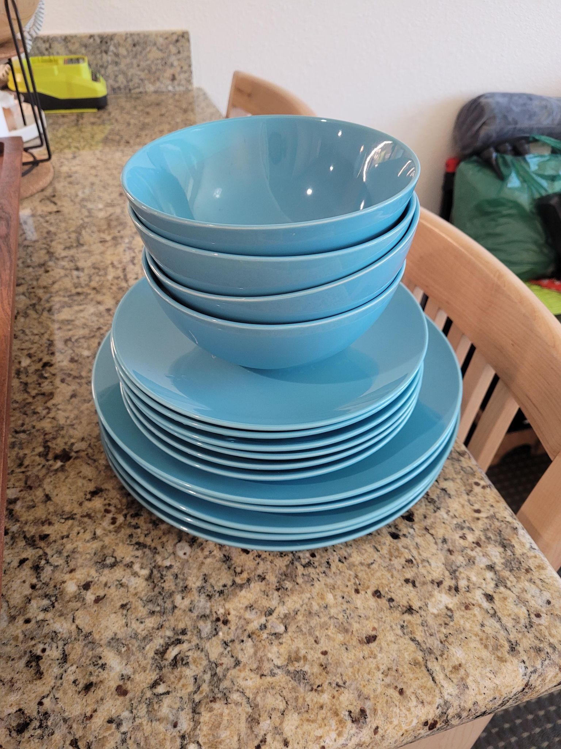
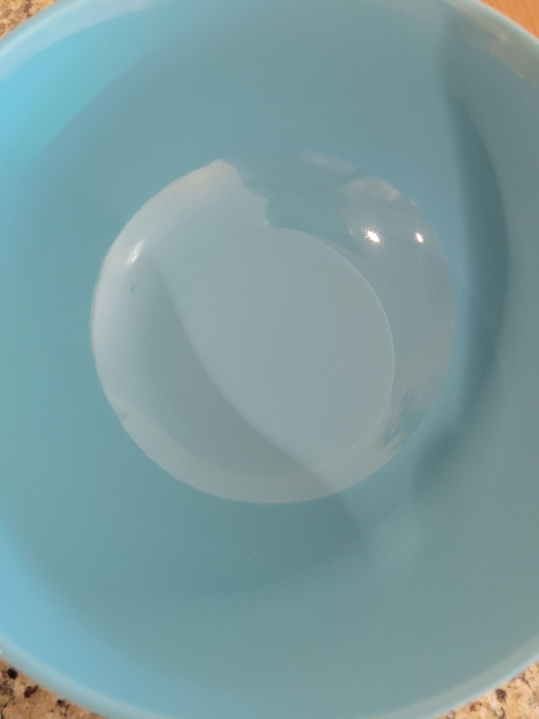

IKEA Light Blue Dinnerware Set(color discontinued) 4 bowls, 6 small plates, 5 large plates
Original Price: $60
LINK (Close not exactly)
Asking Price: $15 $10
(Was a 24 set, now 15)

Slide 3
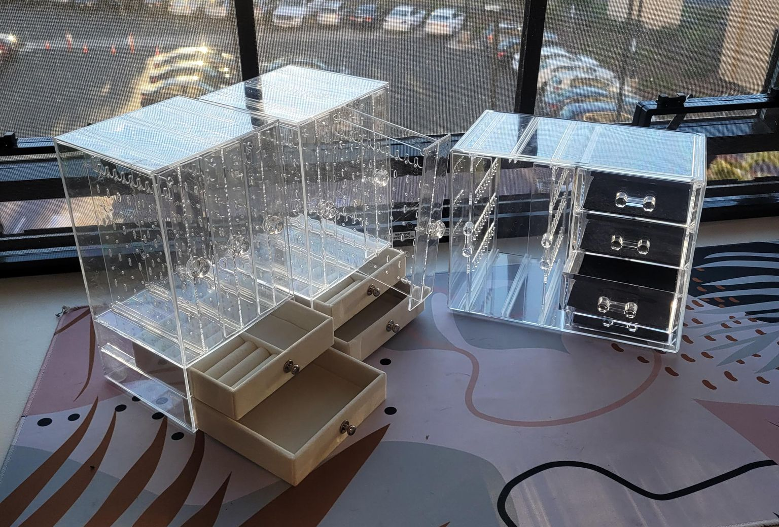
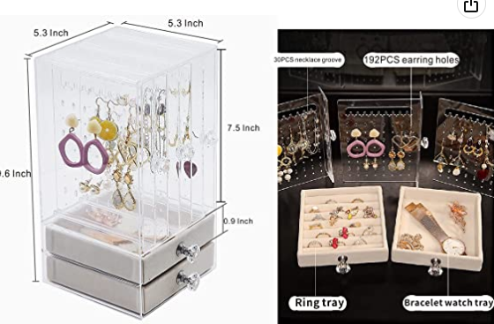
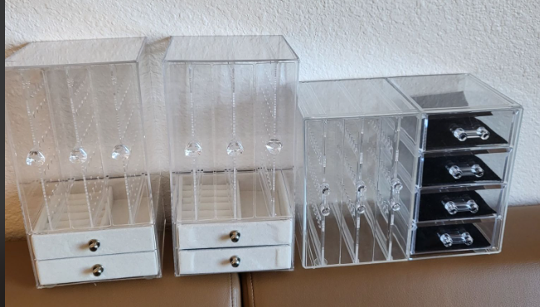
Acrylic Jewelry Box Set
Original Price: $62 (for 3)
LINK1 LINK2
Asking Price: $25

Slide 4
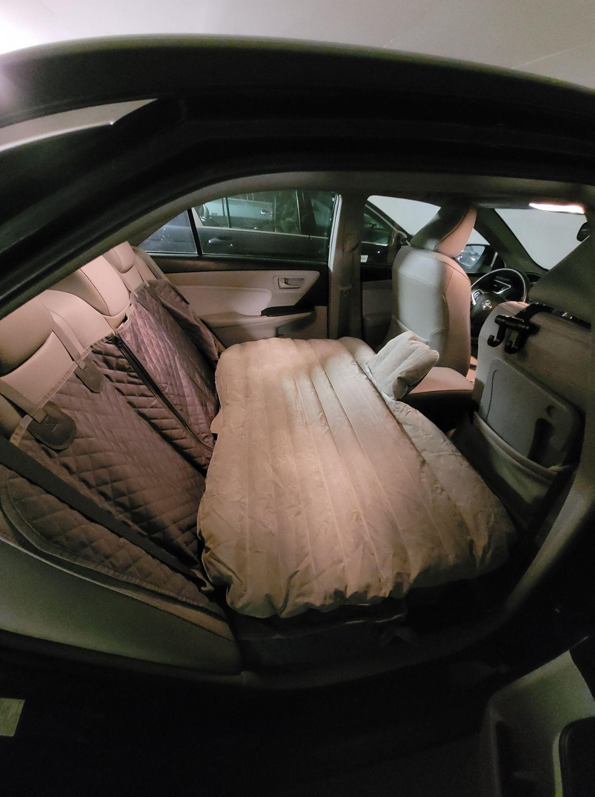
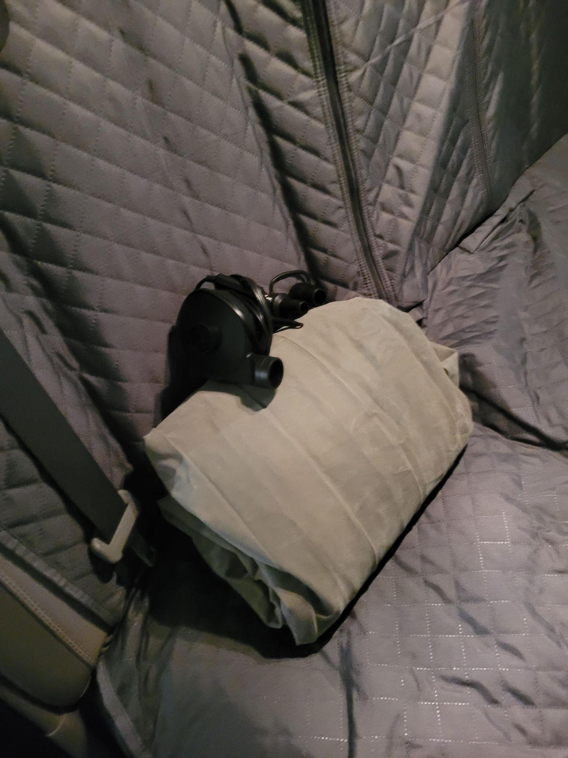
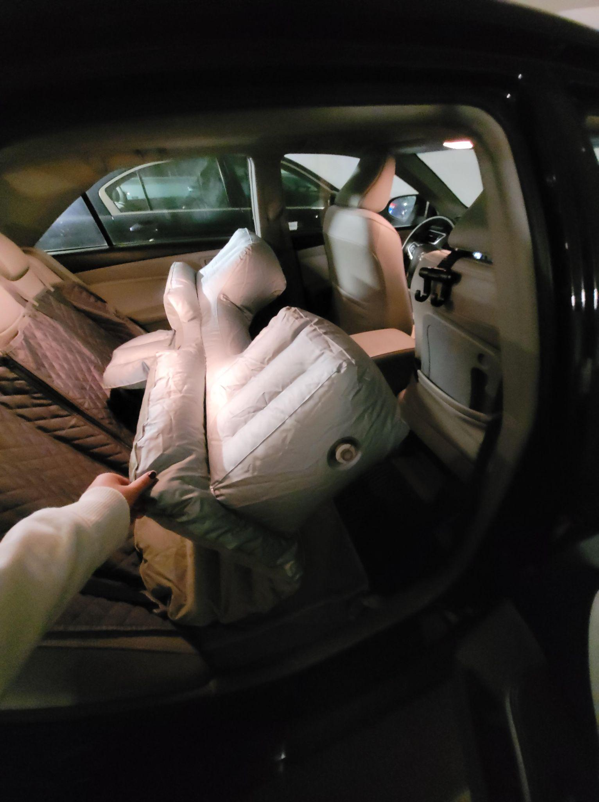
Portable Travel Car Camping Inflatable Air Mattress with Pillow Fits Most Models (with pump)
Original Price: $35.00 (no pillows)
LINK
Asking Price: $25 $15 (Used once)

Slide 5
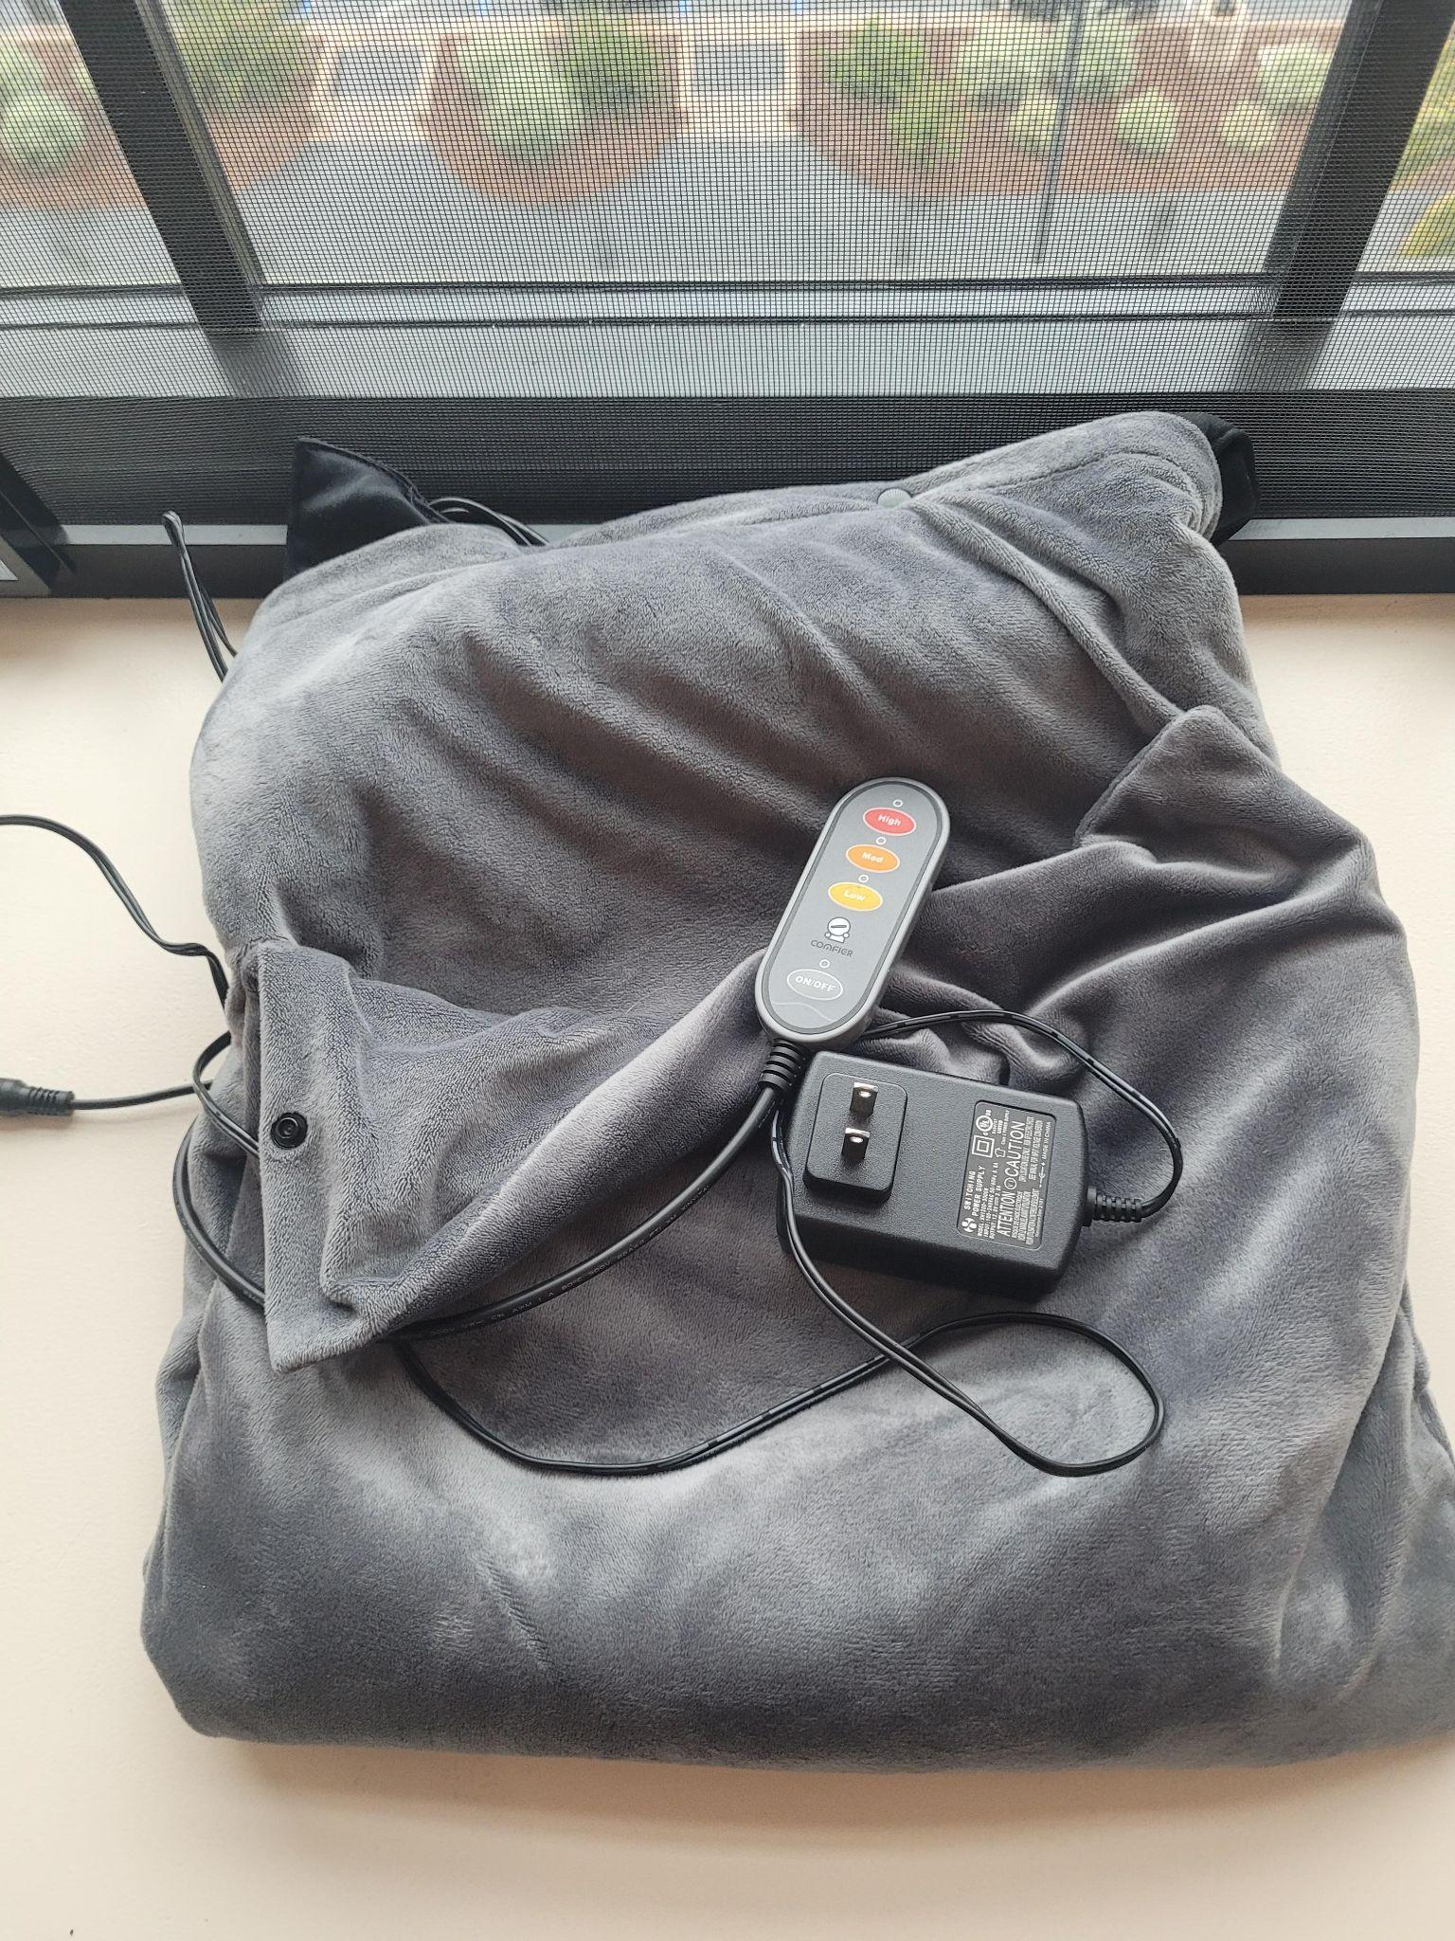
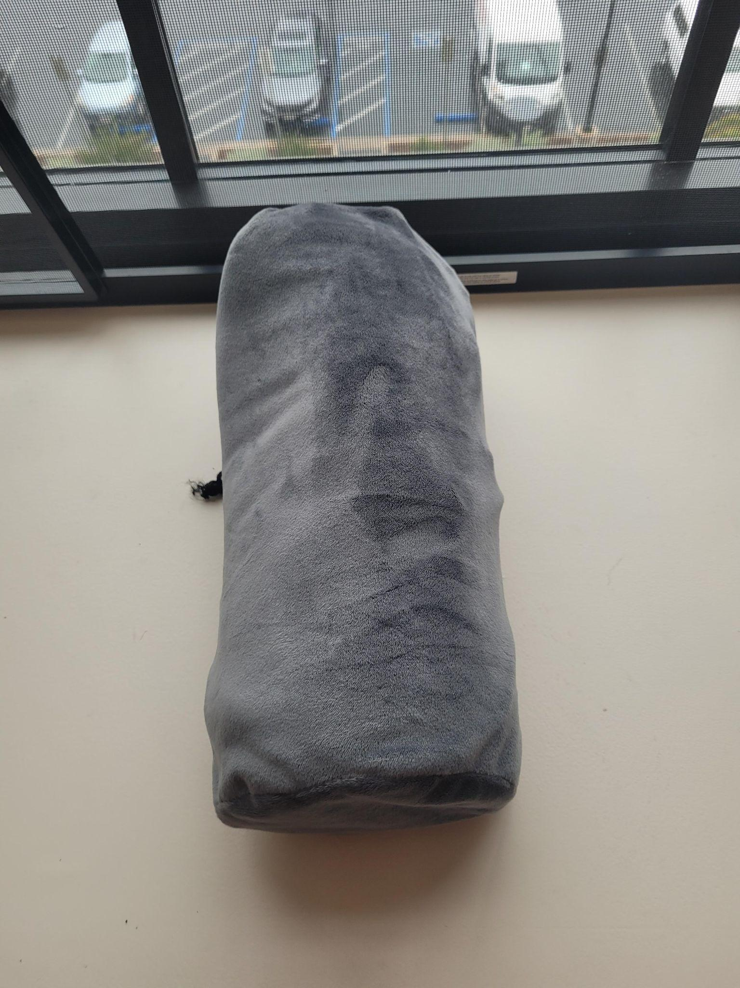
Comfier 2-in-1 Washable Foot Warmer and Heating Pad with Carrying Case
Original Price: $37.00
LINK(Not exact model but very close, this one has buttons not zippers)
Asking Price: $10 $5 (Used 1 year) The outside is machine washable and was just washed

Slide 6
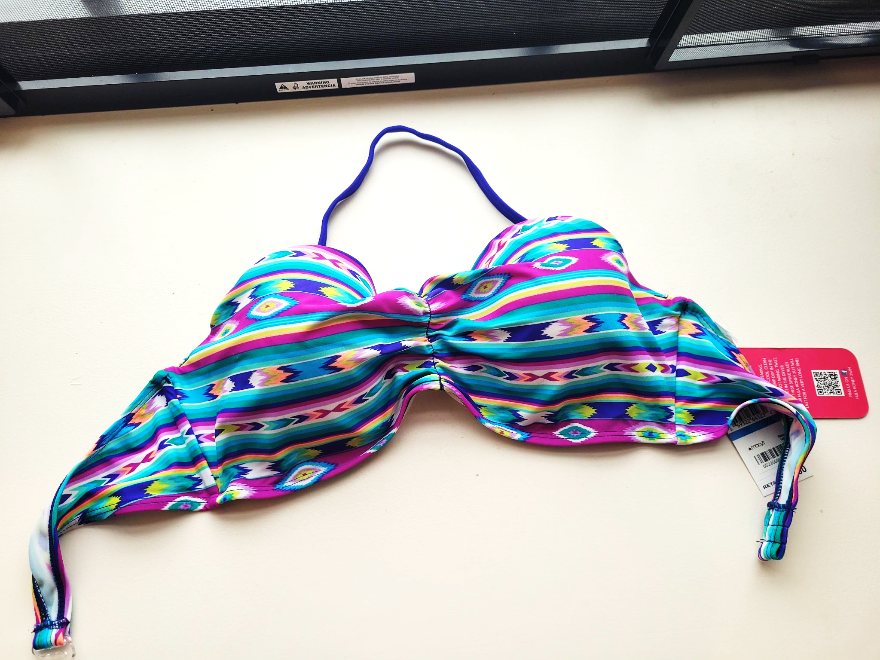
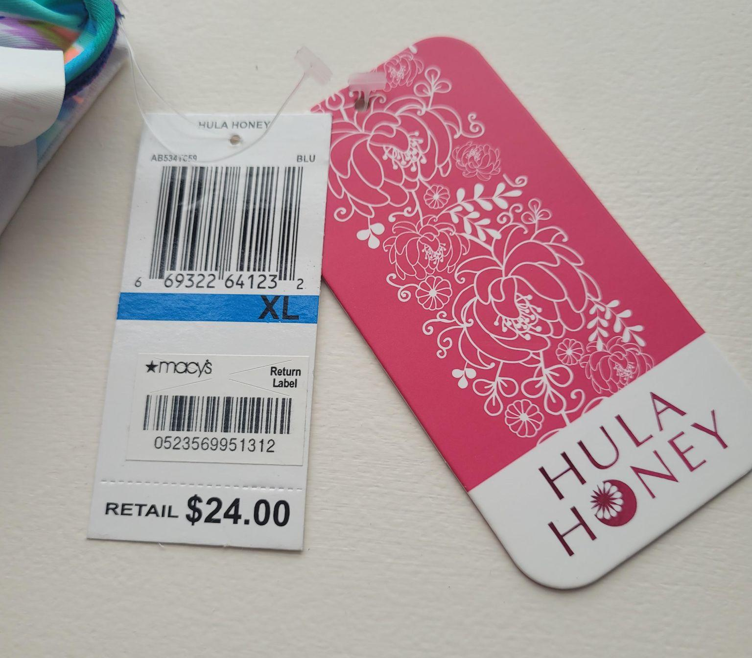
WOMEN'S CLOTHING
XL Bikini Top Original Price: $24.00
Asking Price: $20 $5 (Never Worn)

Slide 7

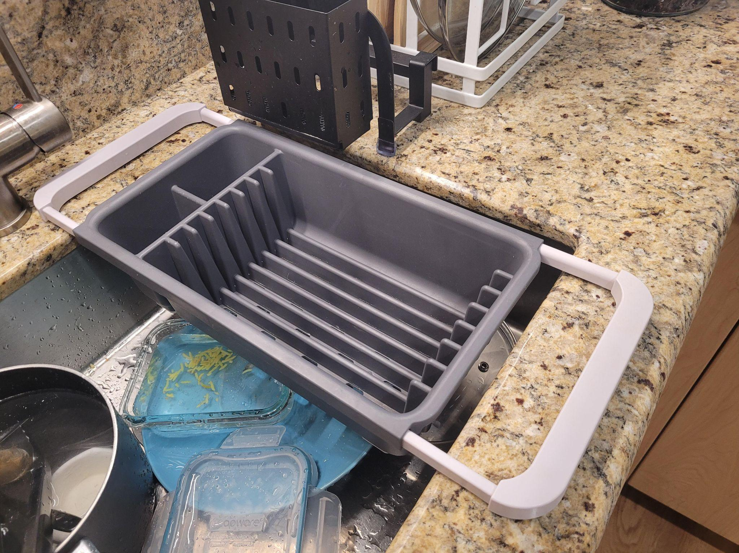
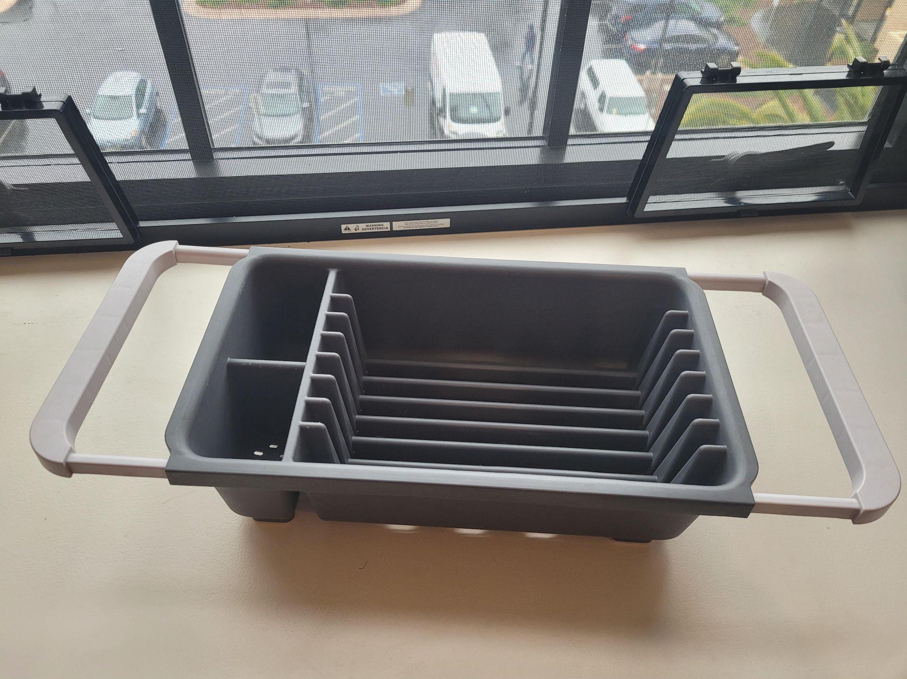
Adjustable Over the Sink Dish Drainer
FOR SALE Original Price: $14.00
LINK
Asking Price: $10 $5

Slide 8
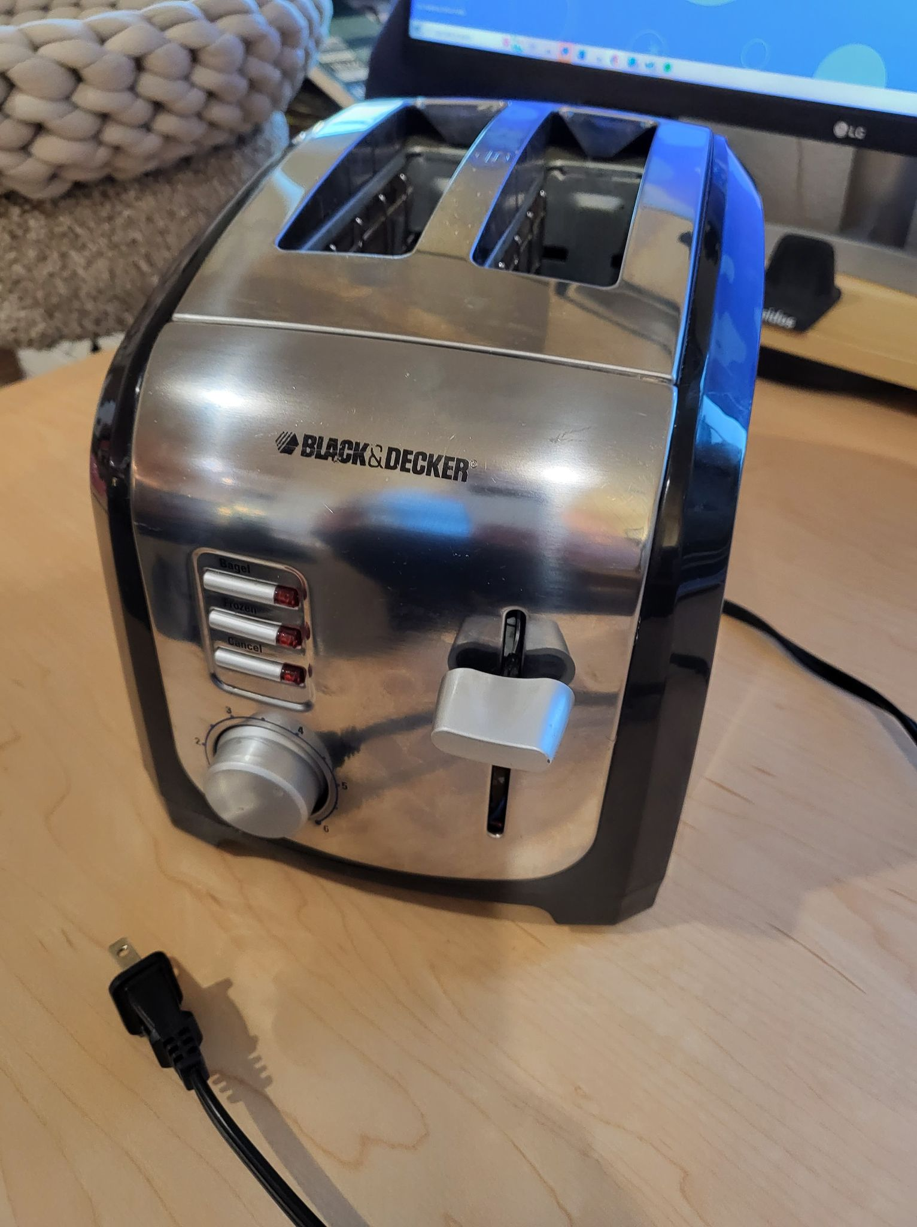
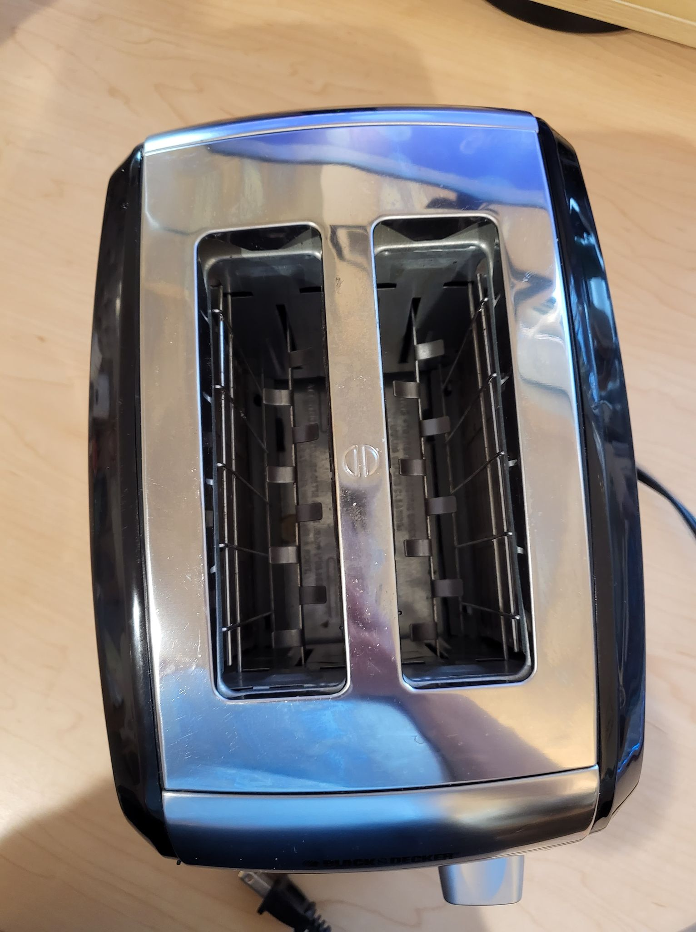
Black & Decker Stainless Steel Toaster
Original Price: $30.00
Asking Price: $10

Slide 9
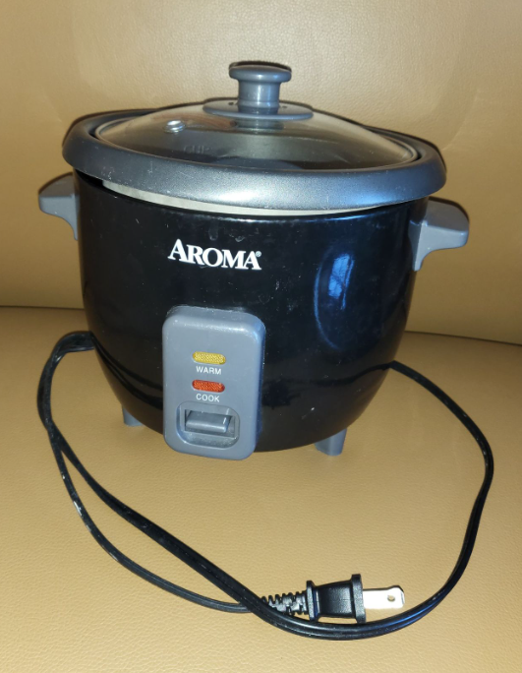
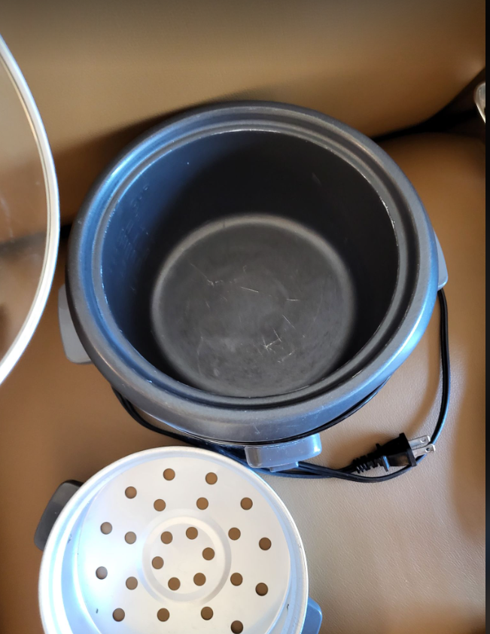
Rice Cooker & Steamer 6 cups cooked (1.2L)
Original Price: $30.00
LINK
Asking Price: $7

Slide 10
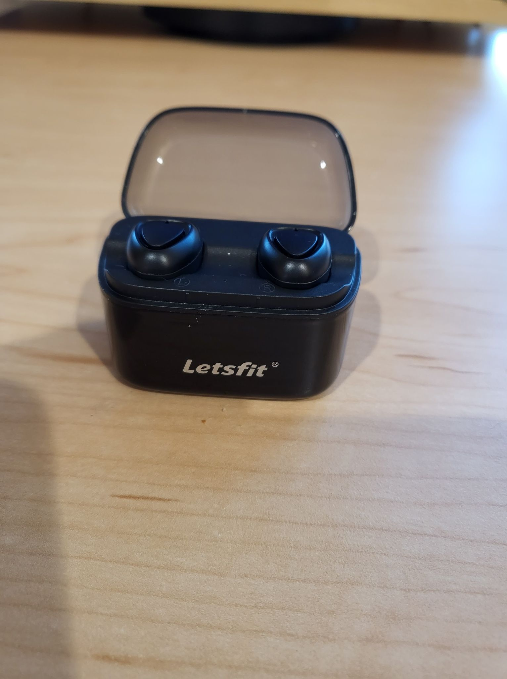
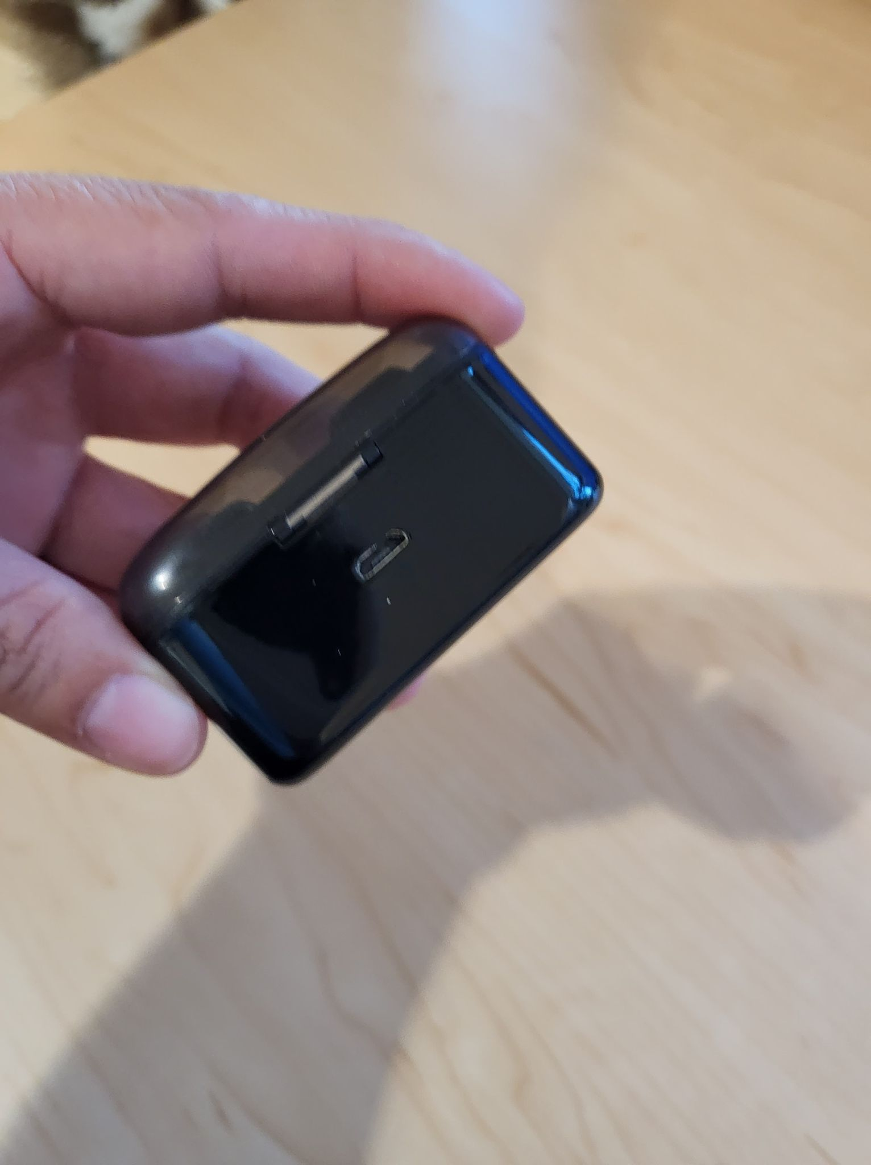
Letsfit Bluetooth Earbuds
FOR SALE Original Price: $45.00
Asking Price: $10

Slide 11
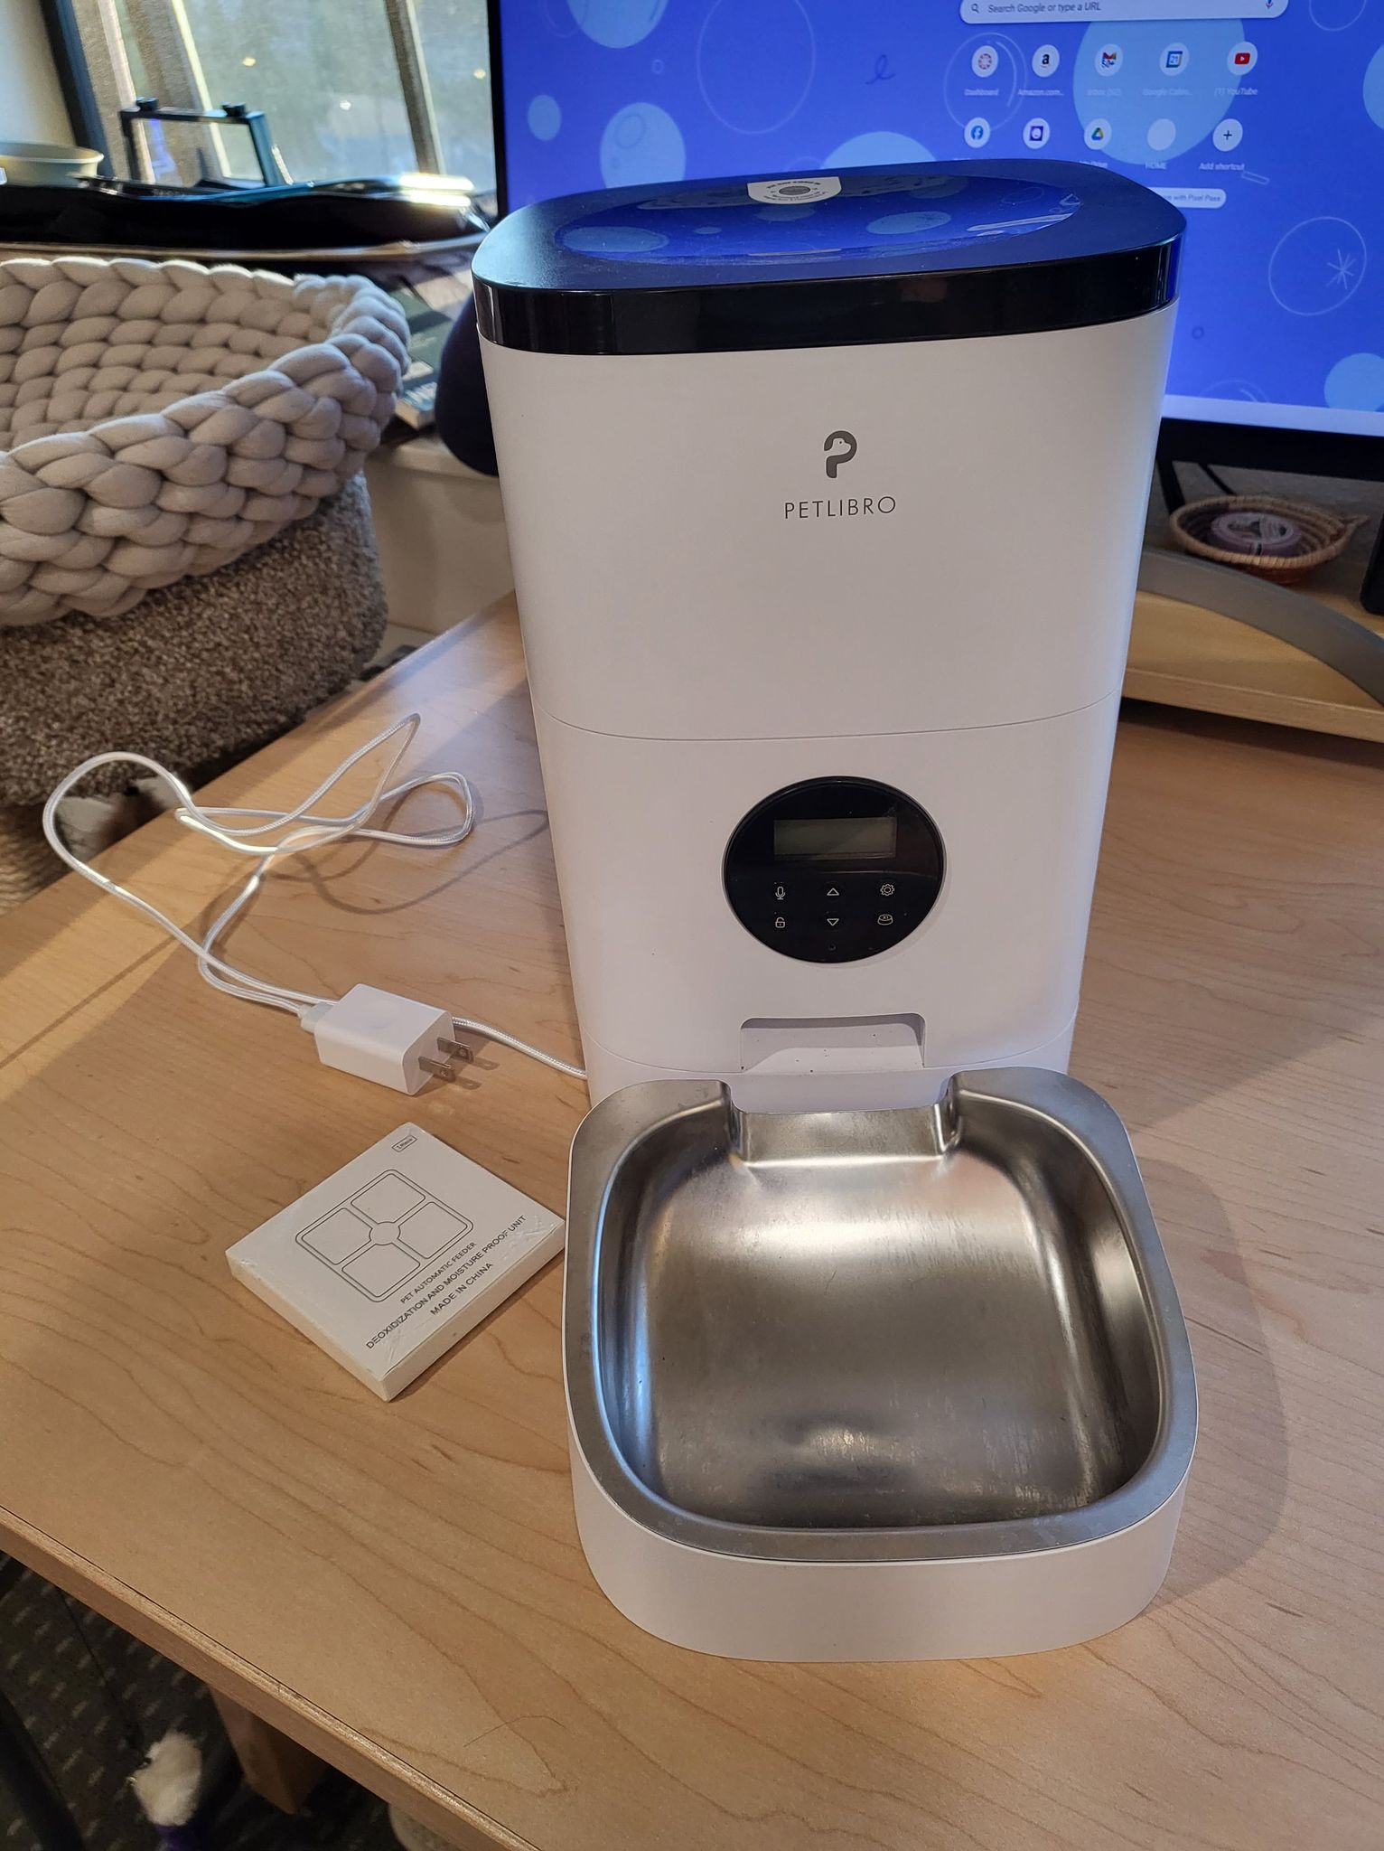
PETLIBRO Automatic Cat Feeder, Timed Cat Feeder with Desiccant Bag for Pet Dry Food, Programmable Portion Control 1-4 Meals per Day & 10s Voice Recorder for Cats and Dogs 4L/6L
Original Price: $80.00
LINK
Asking Price: $50 (Like New)

Slide 12
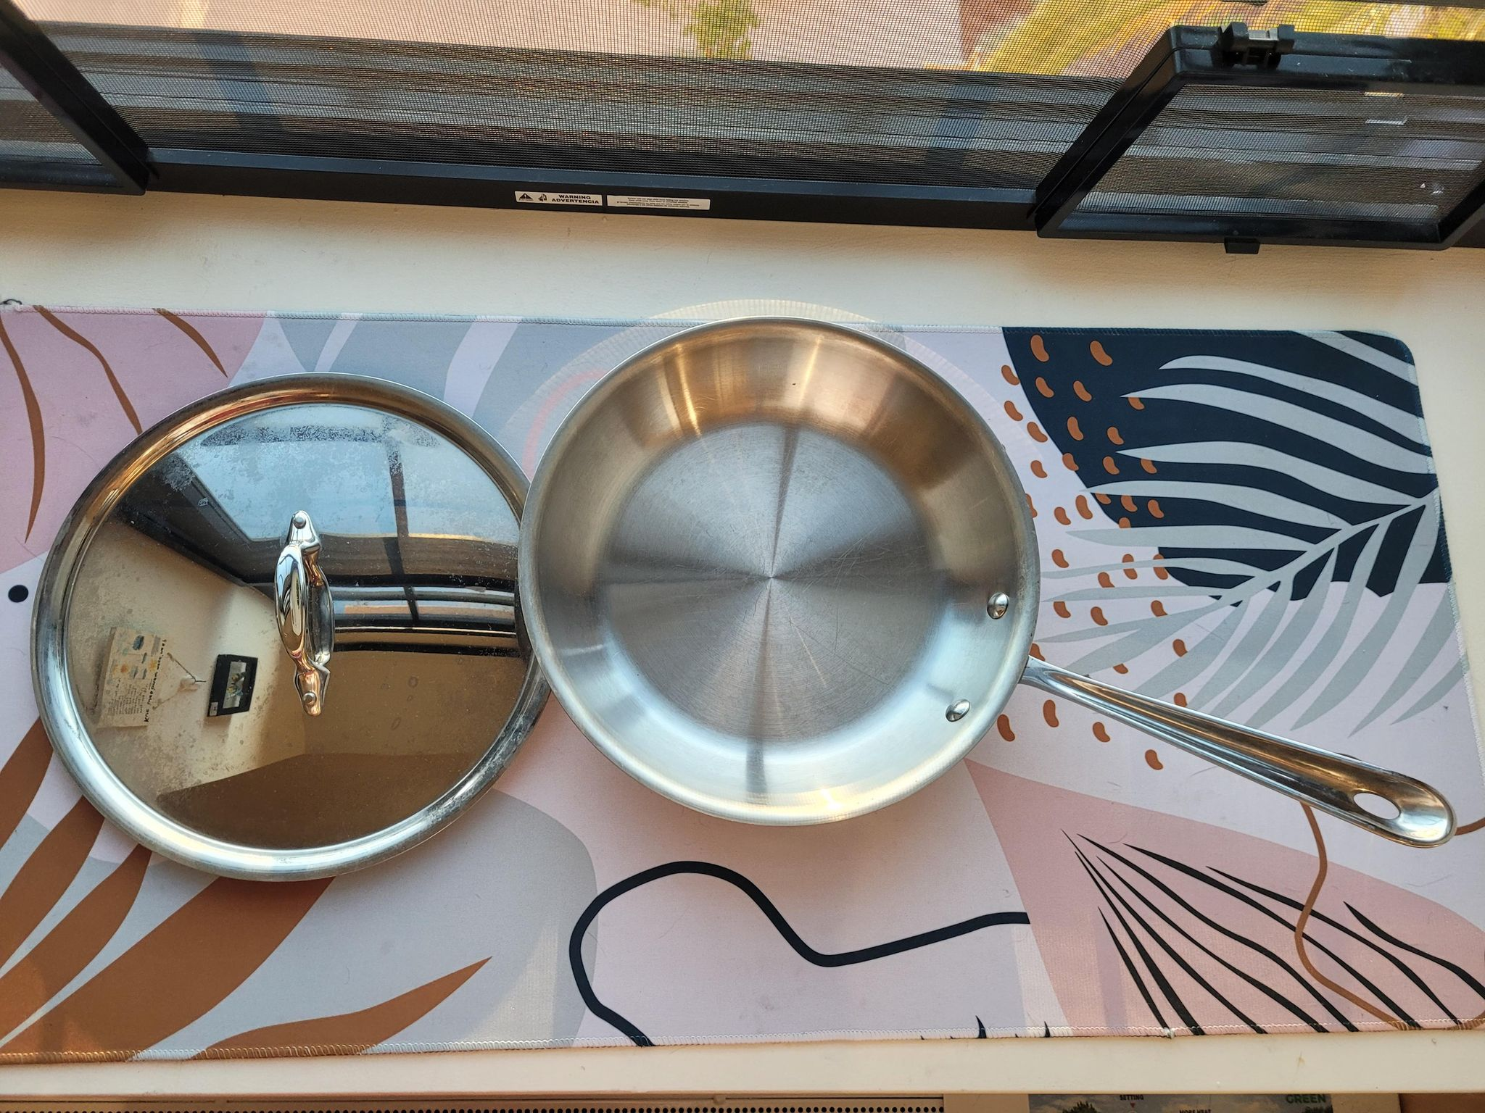
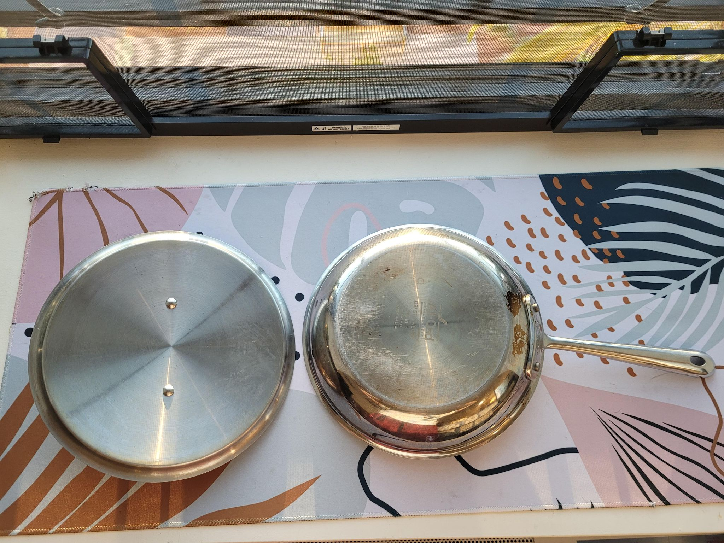
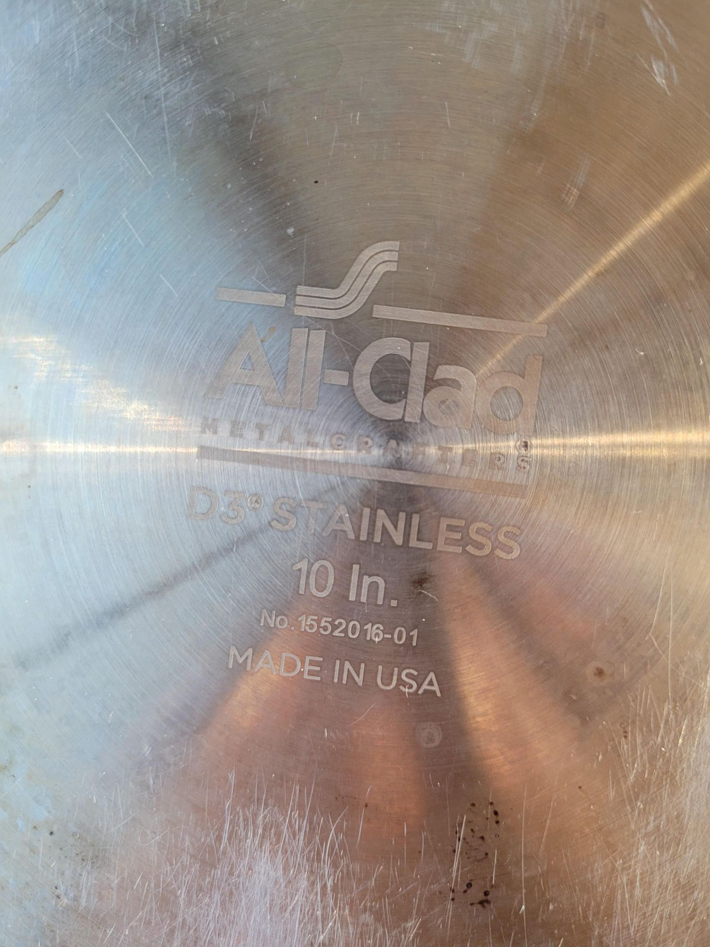
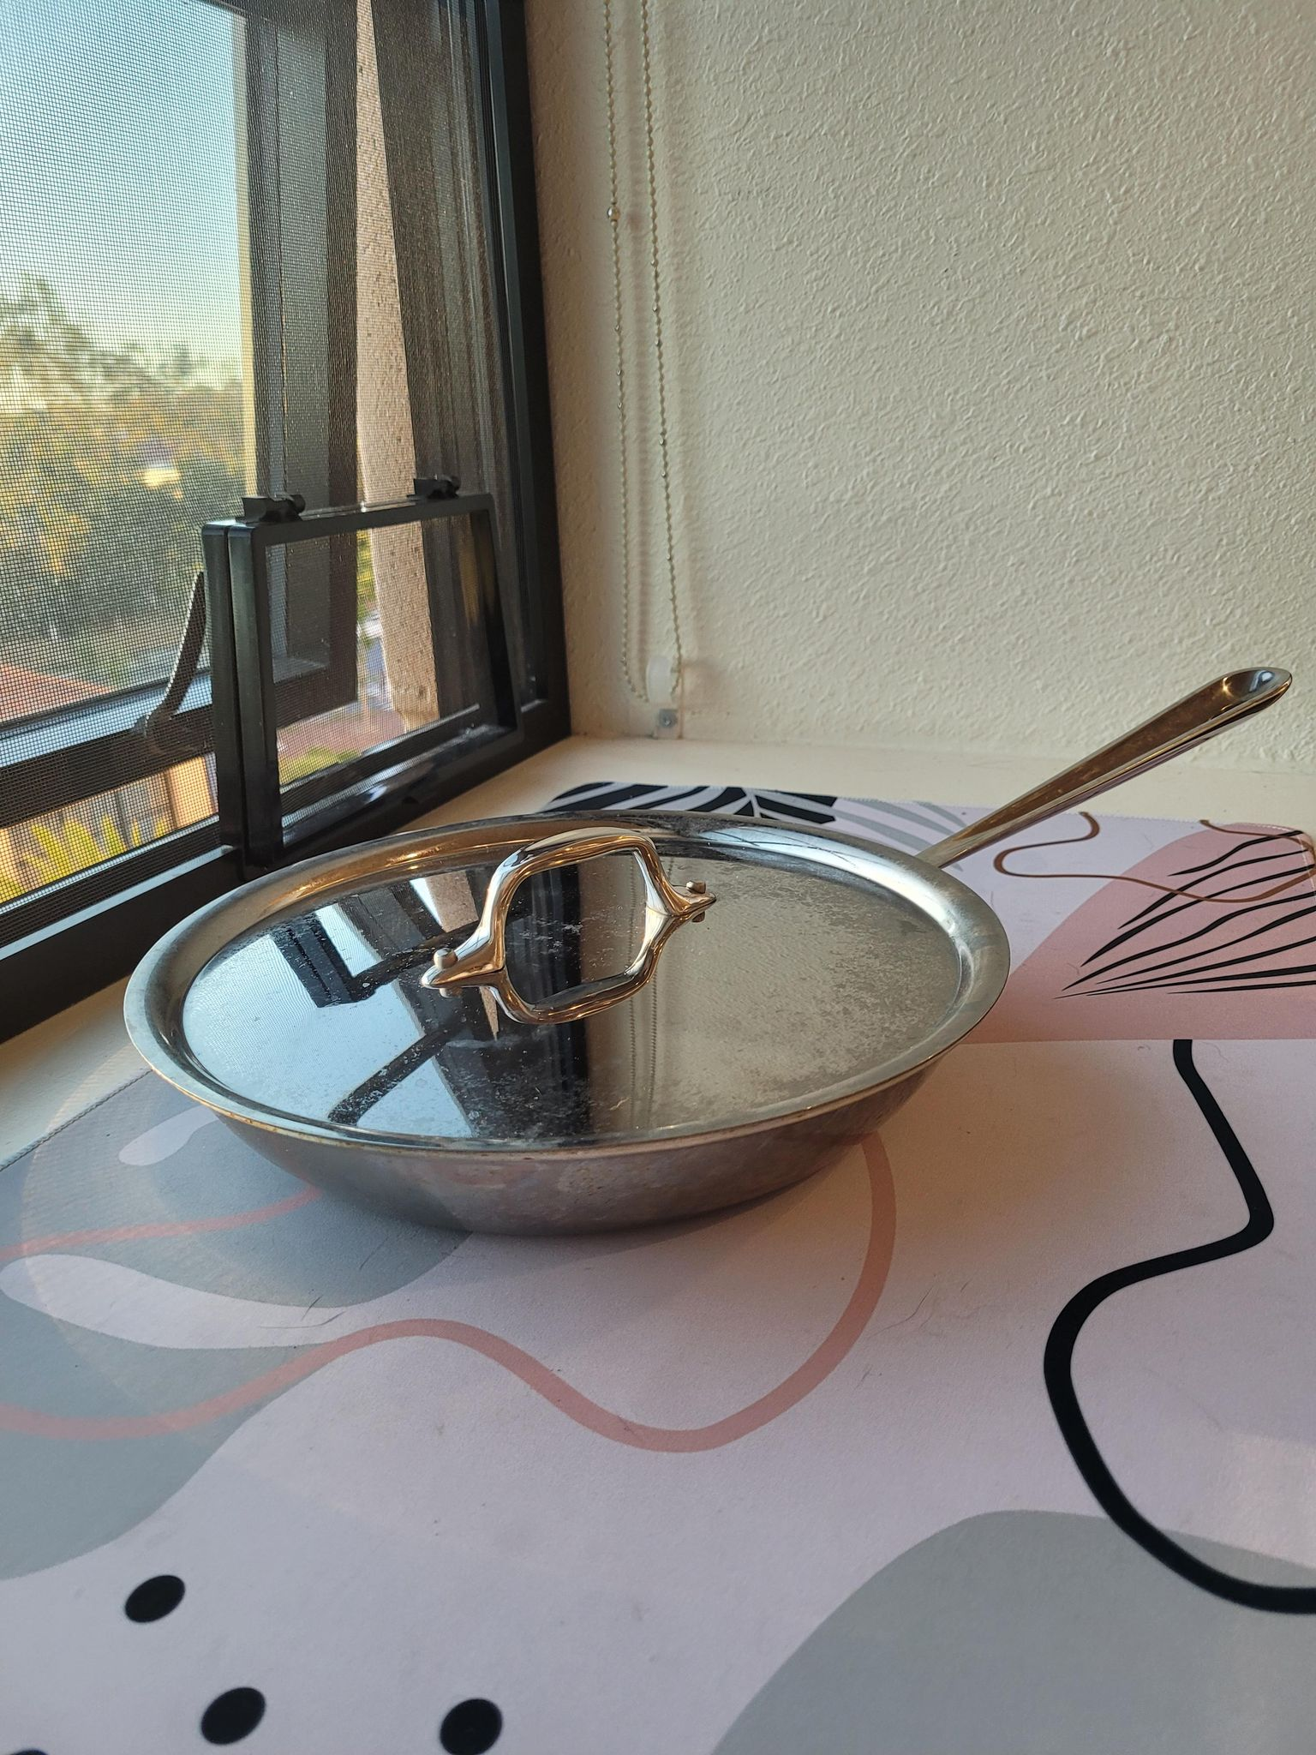
All-Clad D3 Fry Lid, 10 Inch Pan, Dishwasher Safe Stainless Steel Cookware, Silver, 10-Inch
Original Price: $100.00
LINK
Asking Price: $45

Slide 13
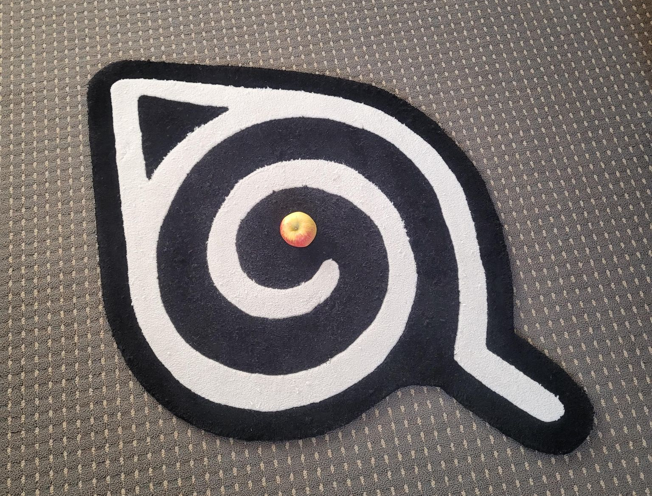

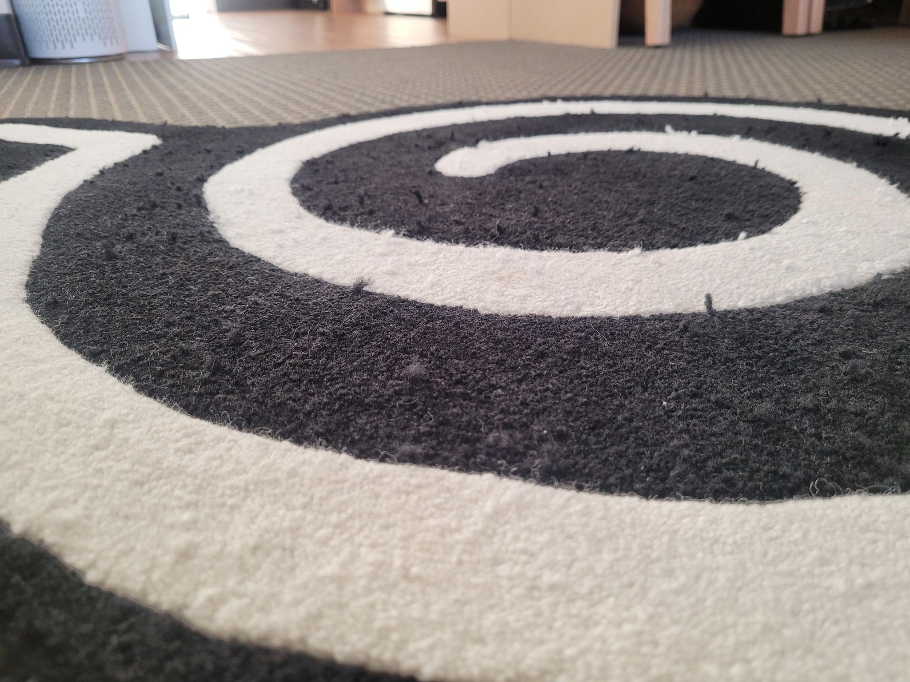
NARUTO LEAF VILLAGE RUG, HYPLAND
Original Price: $150.00
LINK
Asking Price: $75 $50
Apple on top pic for scale

Slide 14
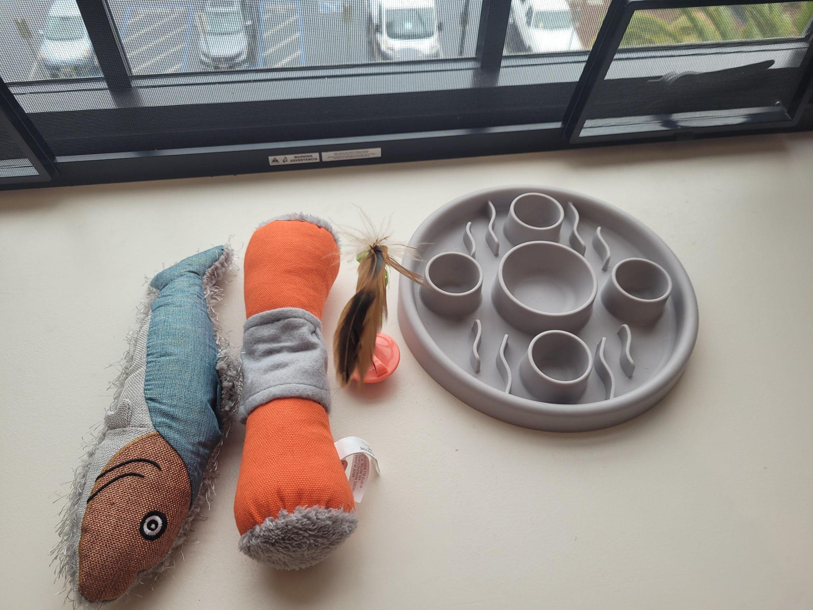
MISC CAT/DOG TOYS P1
FOR SALE Kicker Cat Toy with Catnip (Orange) Original Price: $10.17 https://www.amazon.com/gp/product/B07DHV1F7Q/ref=ppx_yo_dt_b_search_asin_title?ie=UTF8&psc=1
Asking Price: $7 (never used)
FOR SALE Food slow feeder (grey) Original Price: $10
Aking Price: $5 (Basically new)
FOR SALE Fish Catnip Kicker: $7 https://www.petsmart.com/cat/toys/plush-toys/whisker-city-fish-kicker-cat-toy---catnip-plush-53261.html
Asking Price: $5 (Basically new)
FOR SALE Batting Toy (orange with feathers)
Asking Price: $3

Slide 15
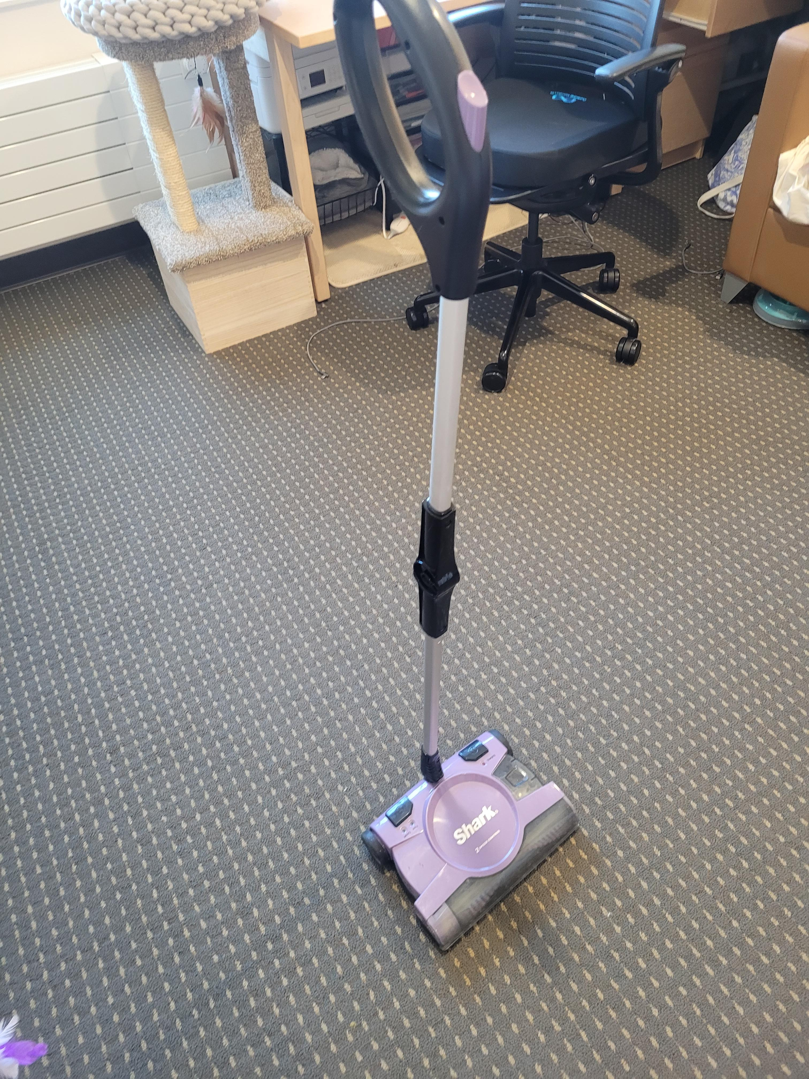
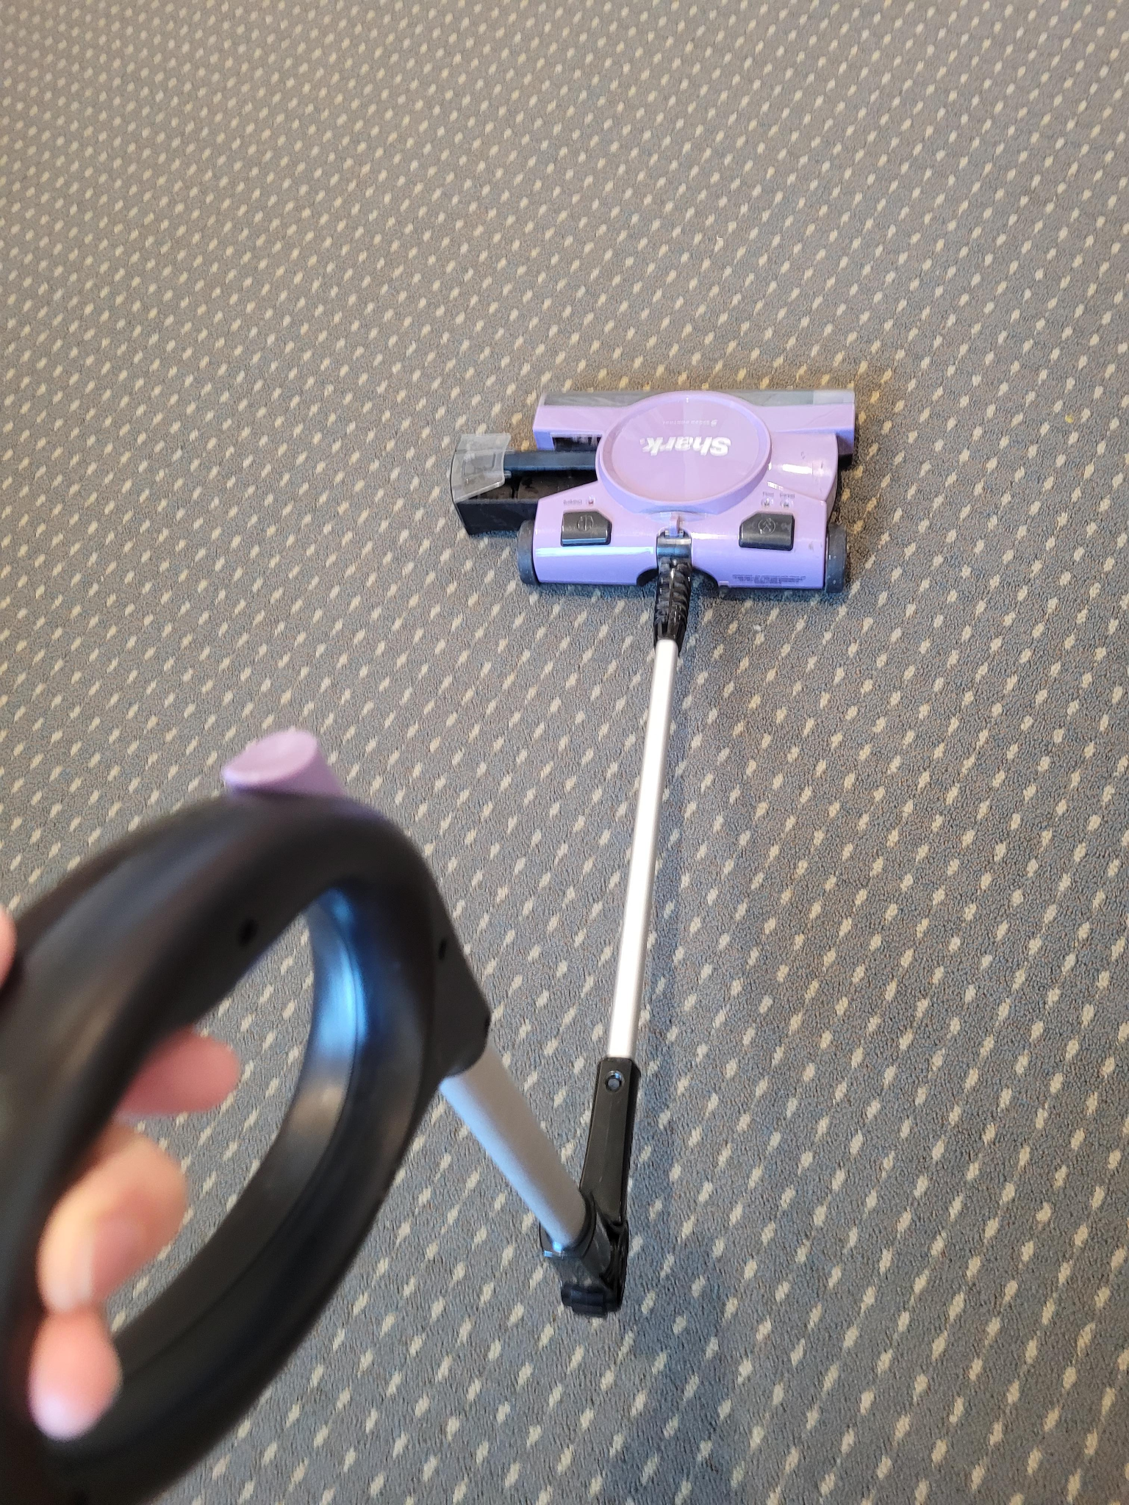
Cordless Vacuum Cleaner
Original Price: $60.00, clean, light weight, perfect for dorm room, bends to reach under bed & couch.
https://www.amazon.com/Shark-V2945Z-SWEEPER/dp/B00EF6HN7S/ref=sr_1_3?crid=14QCI03EB0QPJ&keywords=shark+cordless+vacuum+2+speed+v2945z&qid=1653334875&sprefix=shark+cordless+vacuum+2+speed+%2Caps%2C120&sr=8-3
Asking Price: $45

Slide 16
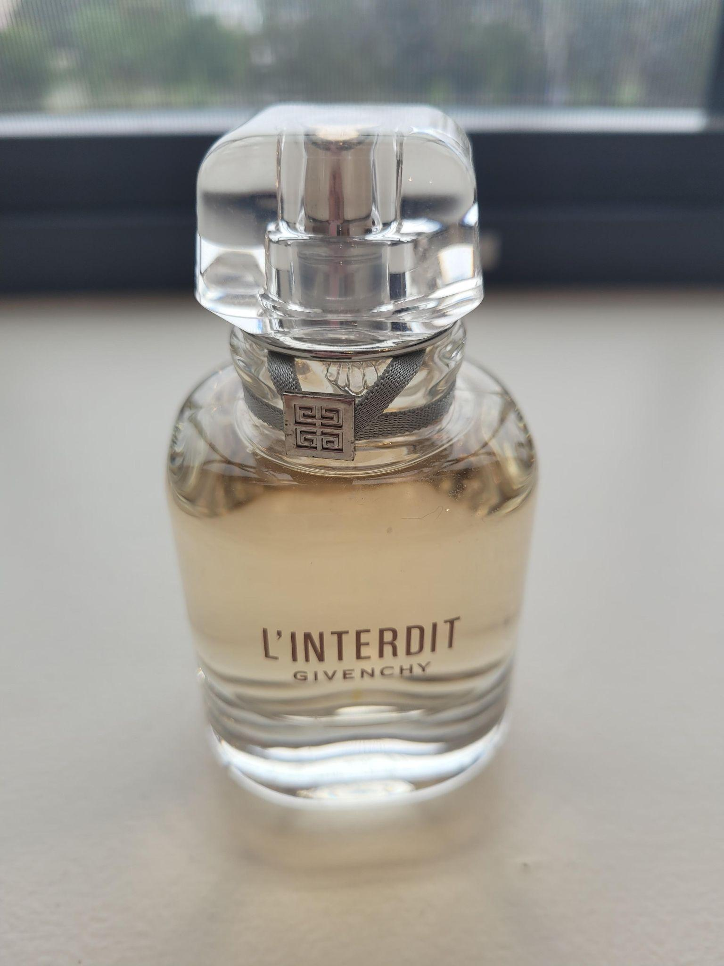
PERFUME: L'INTERDIT EAU DE TOILETTE
Original Price: $80 50 ml https://www.givenchybeauty.com/us/p/l-interdit-F10100125.html?dwvar_F10100125_size=35ml&gclid=Cj0KCQjwmPSSBhCNARIsAH3cYgbaKZpCb6pYDmrBlWSe06rrUB2QM0y_-exghfgdwuJ0zFCRpKd67HMaAjyzEALw_wcB&gclsrc=aw.ds
Asking Price: $60 [Almost Full, Smells great & long lasting. Selling because an ex bought it for me]

Slide 17
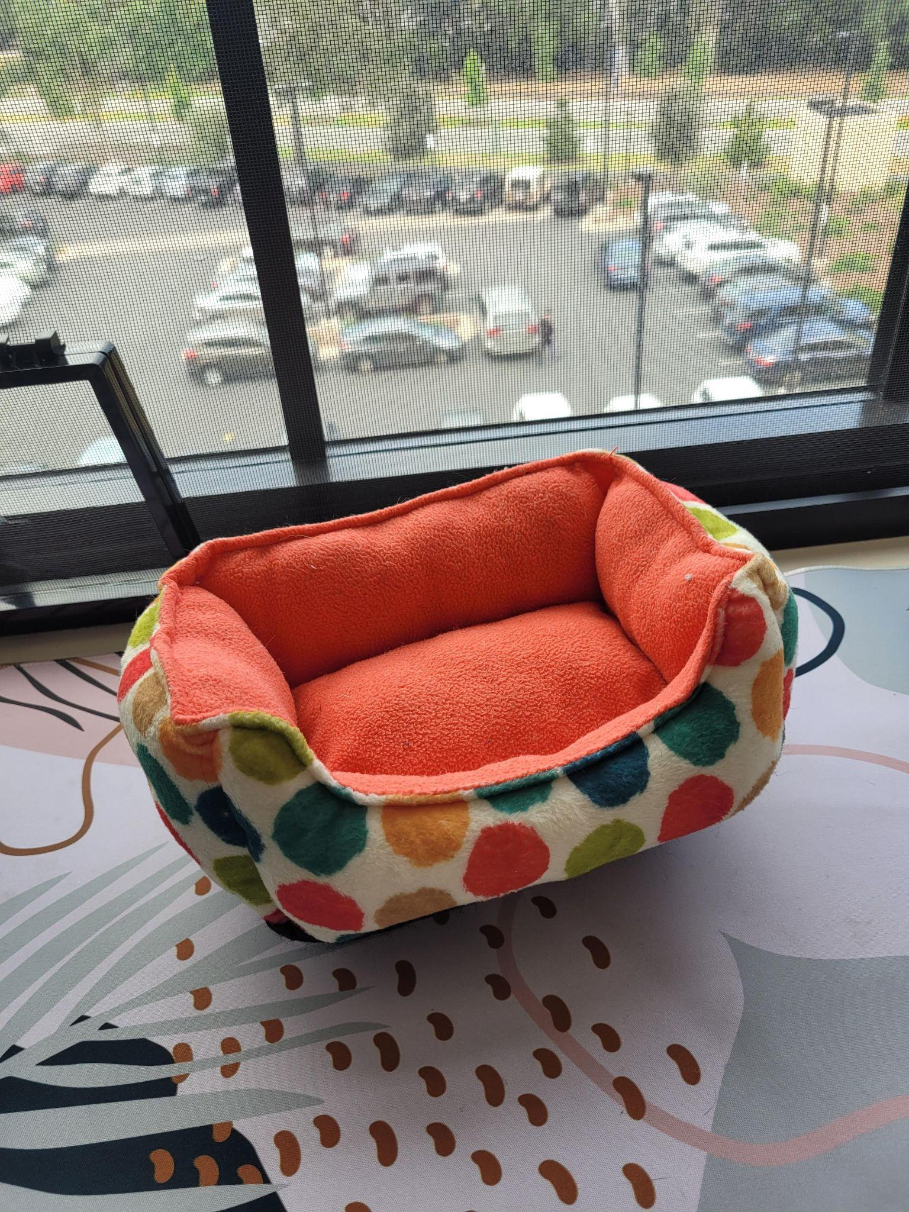
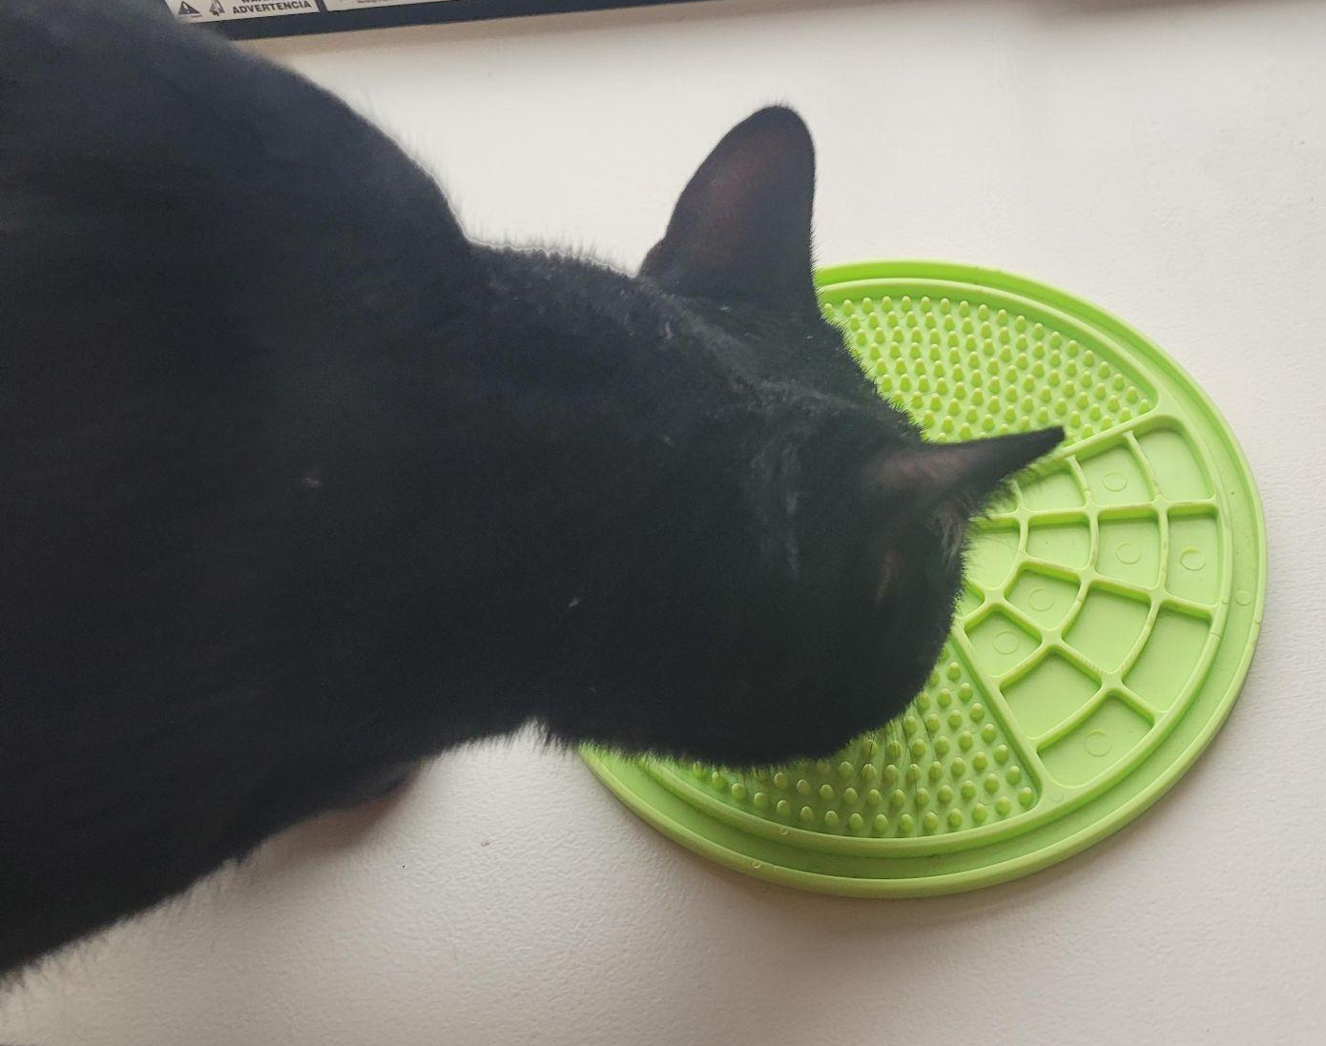
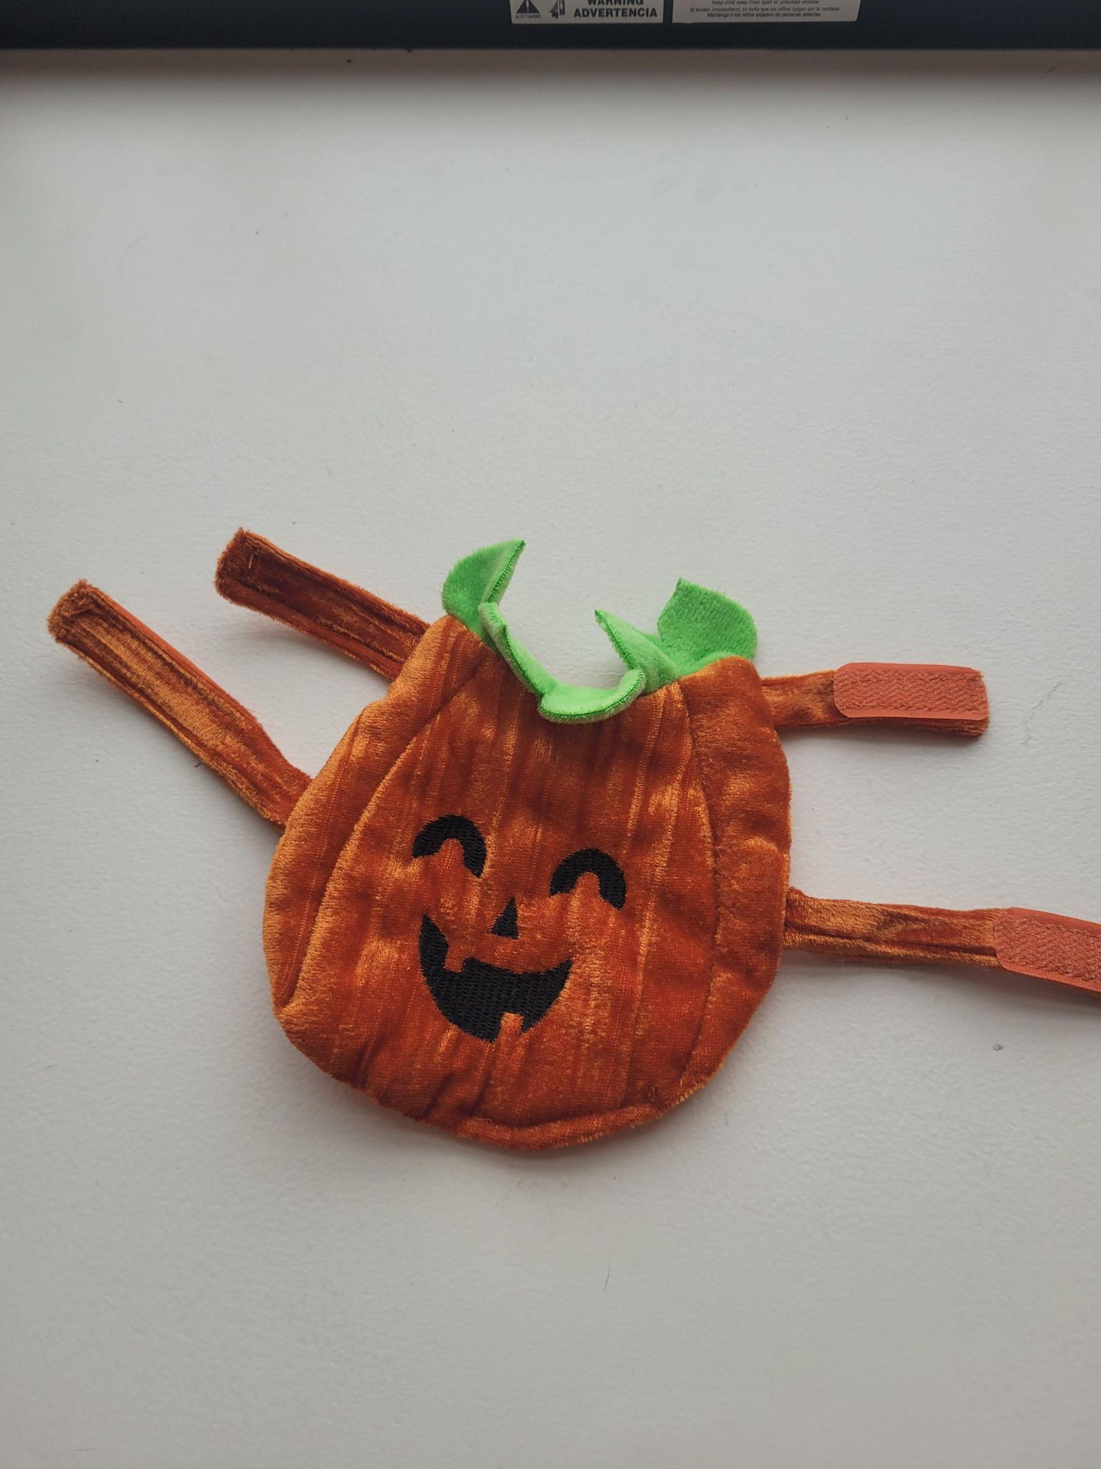
PET TOYS P2
FOR SALE Small Pet Bed (Orange) Original Price: $13.00 https://www.petsmart.com/small-pet/toys-and-habitat-accessories/tunnels-and-hideouts/full-cheeks-small-pet-chevron-cuddler-bed-68322.html
Asking Price: $5 (cat outgrew) also good for bearded dragon, guinea pig, kitten, ferret, etc.
FOR SALE Small lick mat (green) Original Price: $8
https://www.petsmart.com/dog/bowls-and-feeders/placemats/pet-zone-boredom-bustersandtrade-engage-slow-feeder-licking-mat-60274.html
Asking Price: $5 (gently used)
FOR SALE Very Small pet Pumpkin Outfit Original Price $13
Girth 15-16 in, Head to Tail 7-8 in
Asking Price: $2 (Used once) good for bearded dragon, guinea pig, ferret, kitten, etc

Slide 18
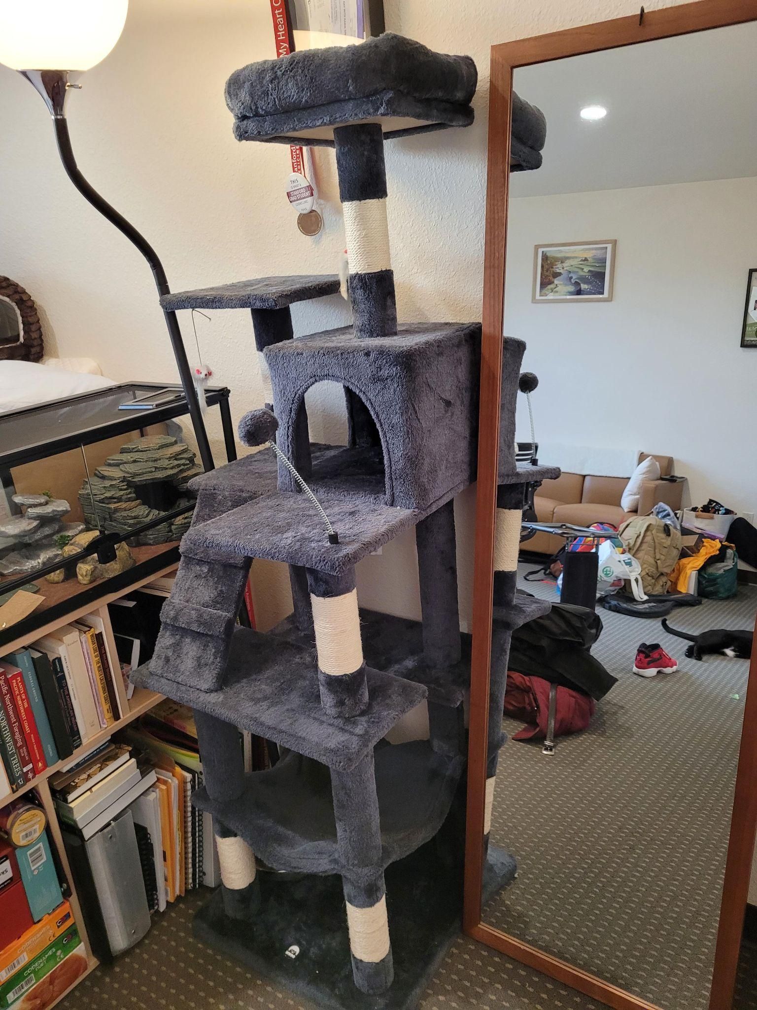
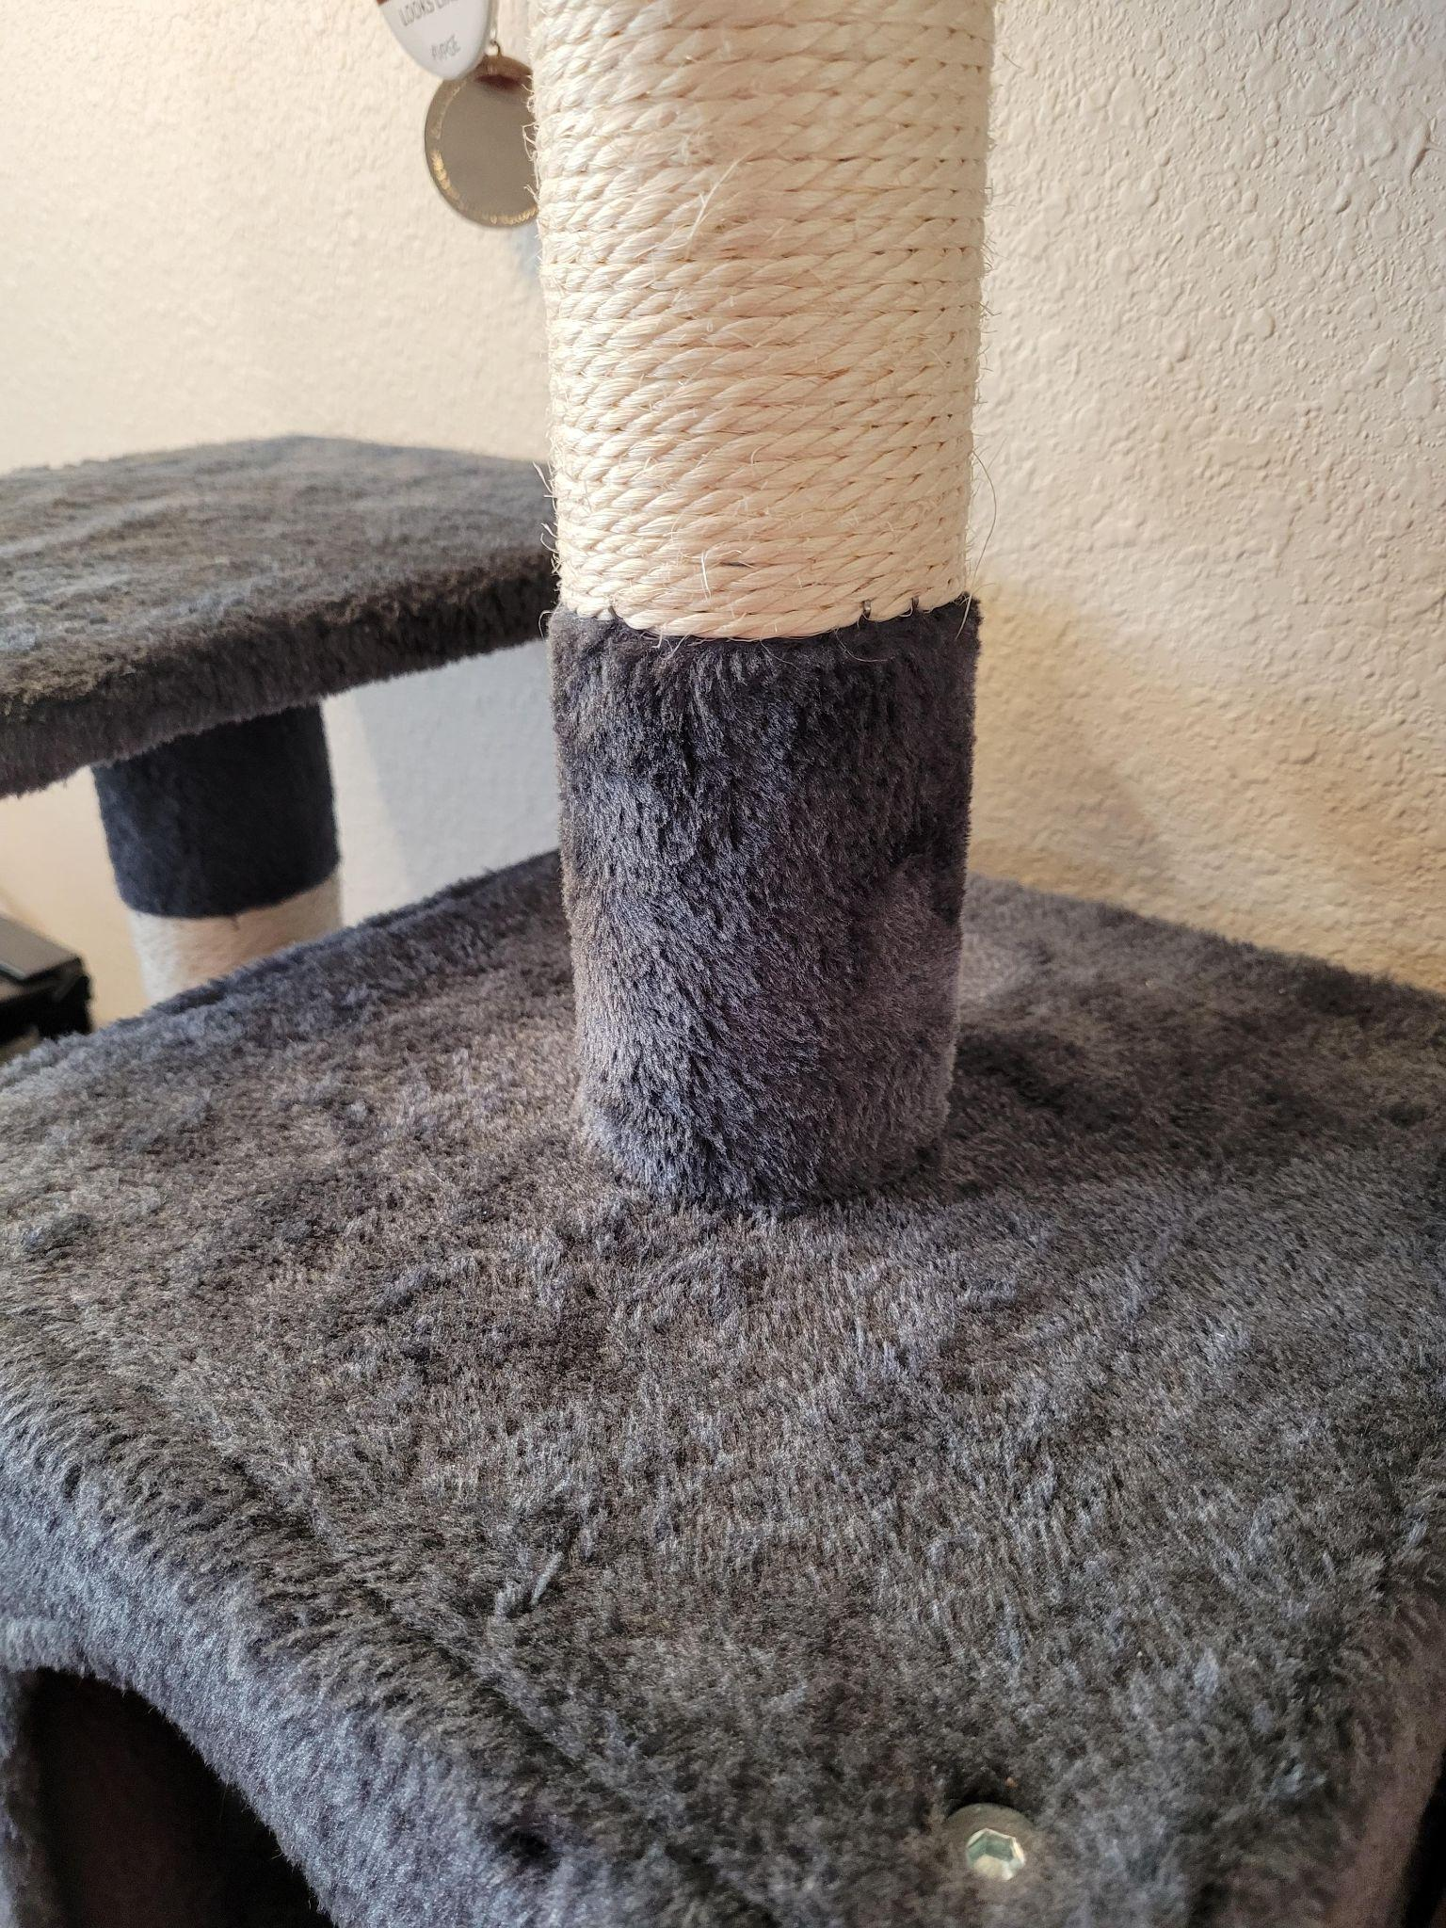
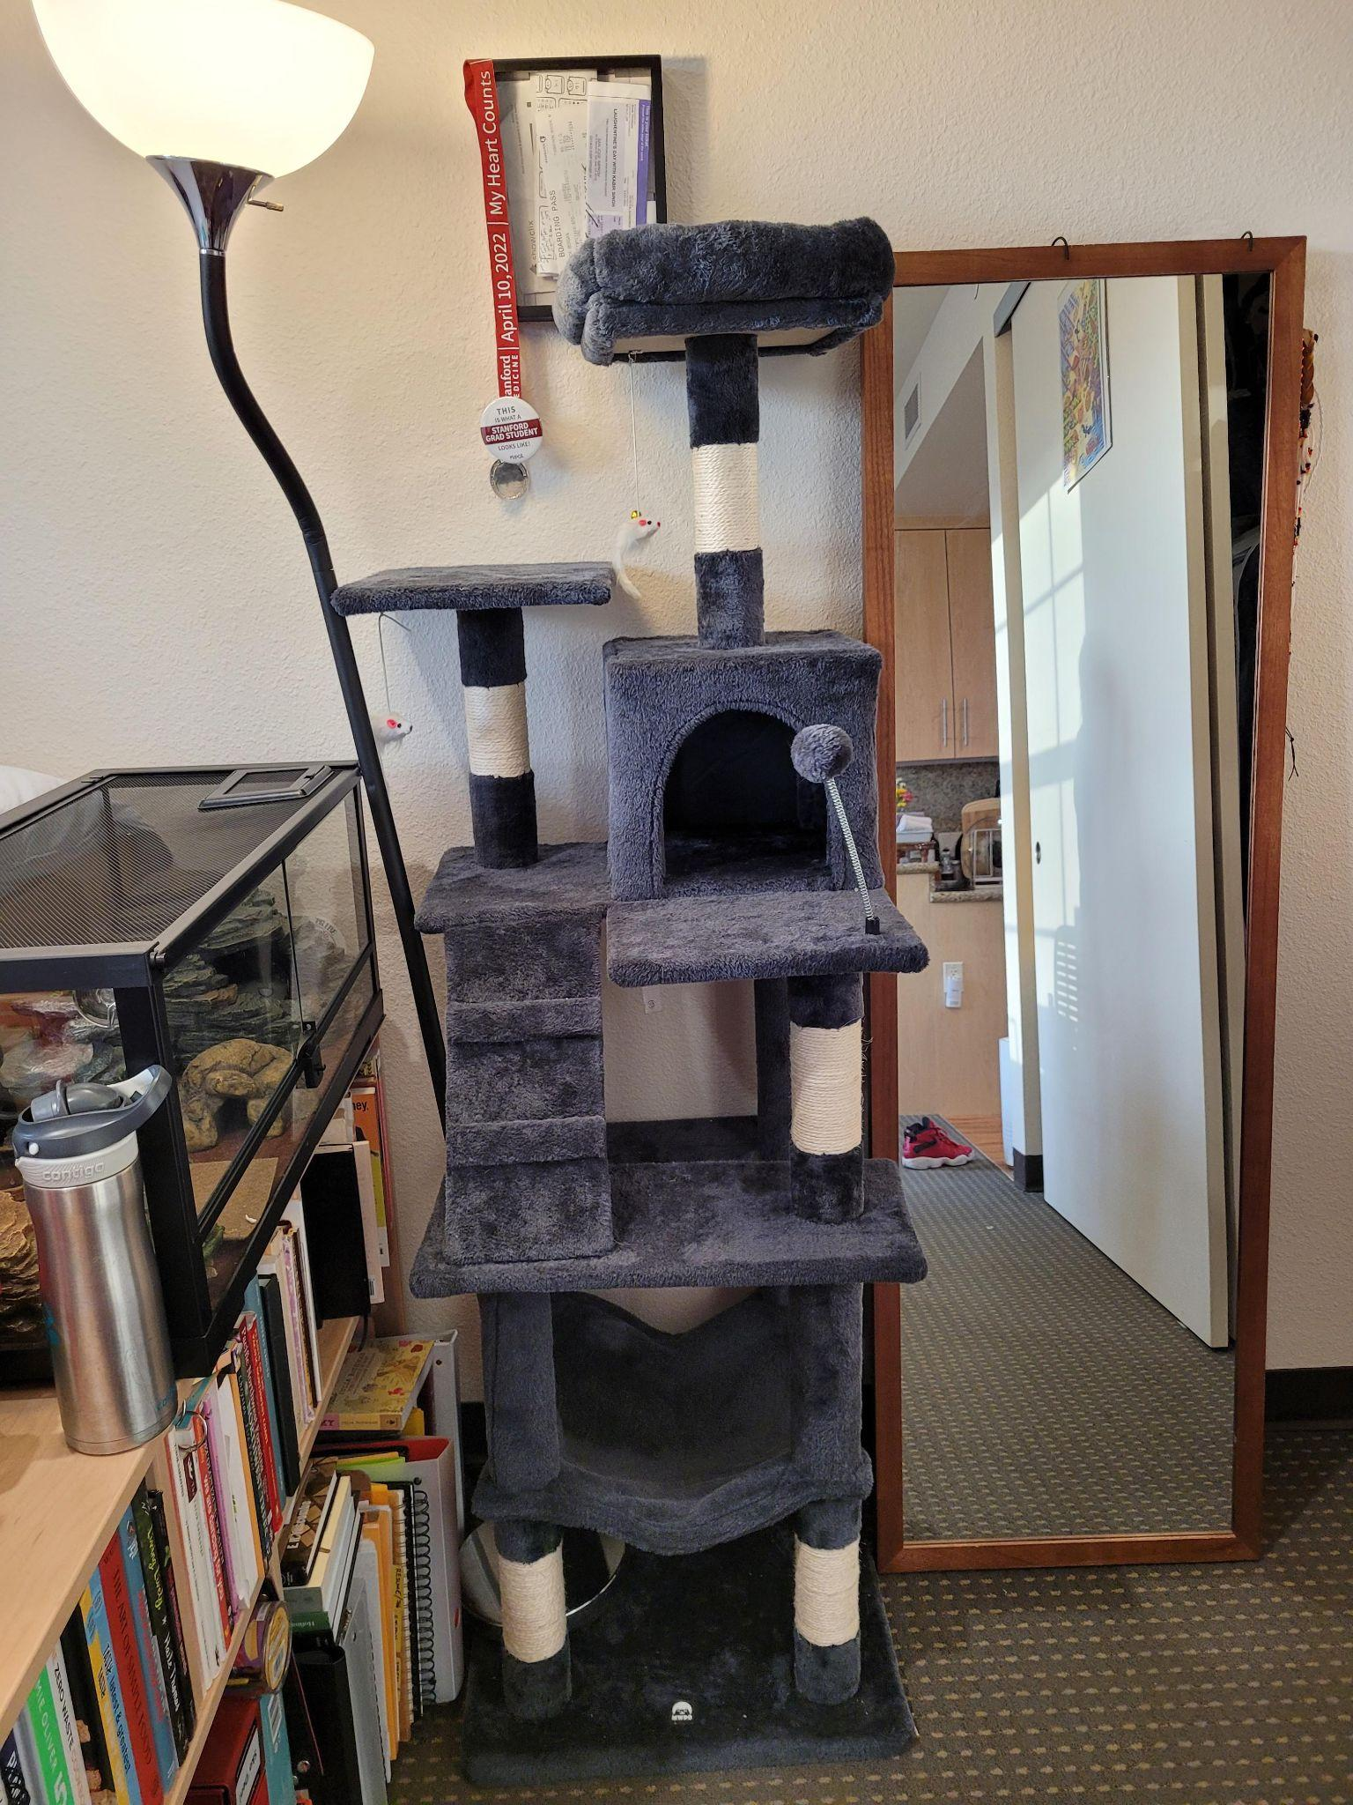
PET TOYS P3: 3 TIER CAT TREE
MWPO 63.8 inches Multi-Level Cat Tree with Sisal-Covered Scratching Posts, Padded Platform, Hammock and Condo, and Stable Cat Tower Cat Condo Pet Play House
Original Price: $80
https://www.amazon.com/gp/product/B08KFXV74T/ref=ppx_yo_dt_b_search_asin_title?ie=UTF8&th=1
Asking Price: $65 OBO (Barely Used, No Hair or smell, Already Assembled) My cat doesn't like it as much as their other spaces and I am moving to a smaller space. Fits well in EVGR

Slide 19
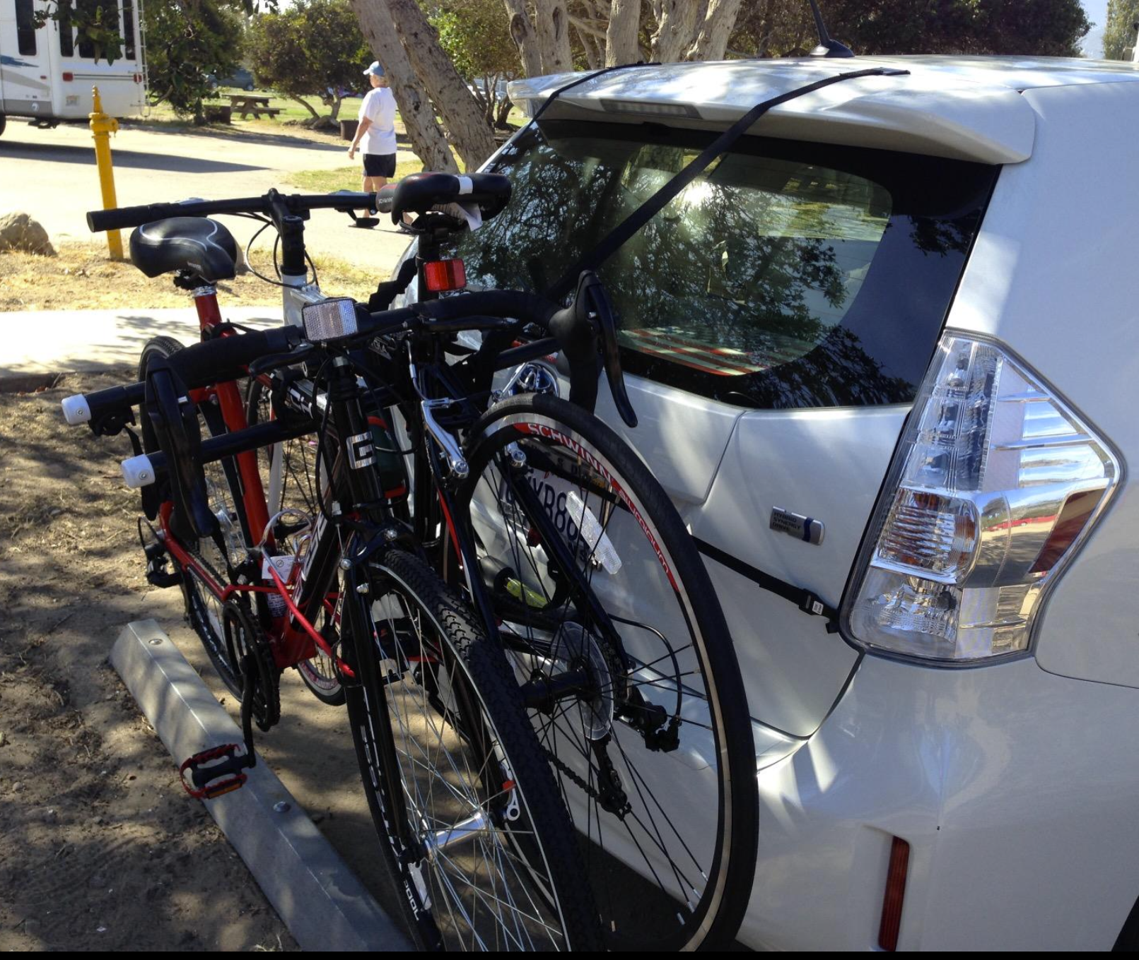
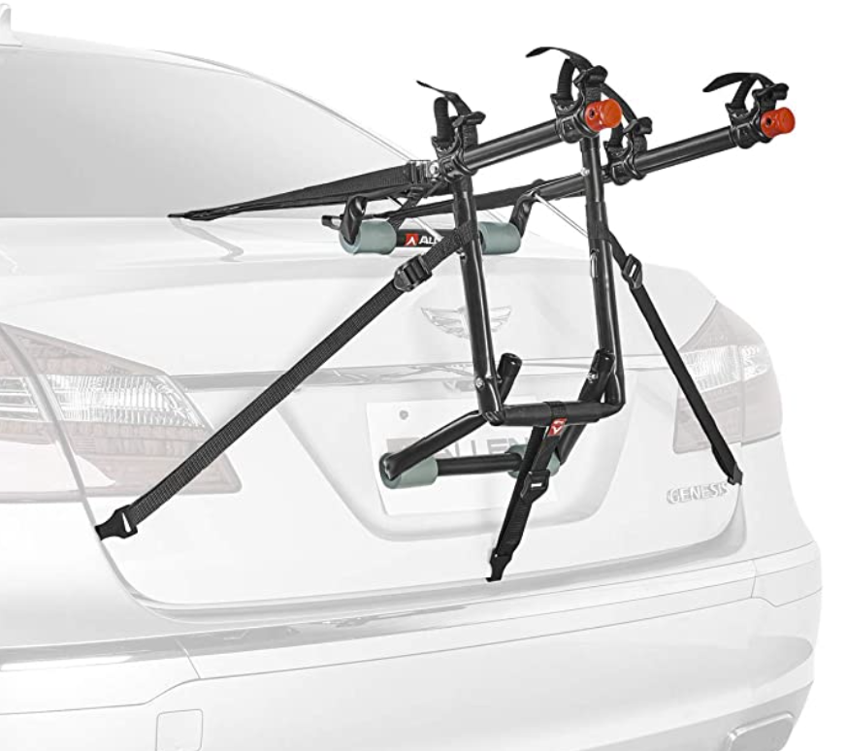
DELUXE TRUNK MOUNTED BIKE RACK
FOR SALE Original Price: $60.00 https://www.amazon.com/gp/product/B00TRTSAZM/ref=ppx_yo_dt_b_search_asin_title?ie=UTF8&th=1
Asking Price: $35 (New & Unused) My bike is a weird artistic shape and does not fit.

Slide 20
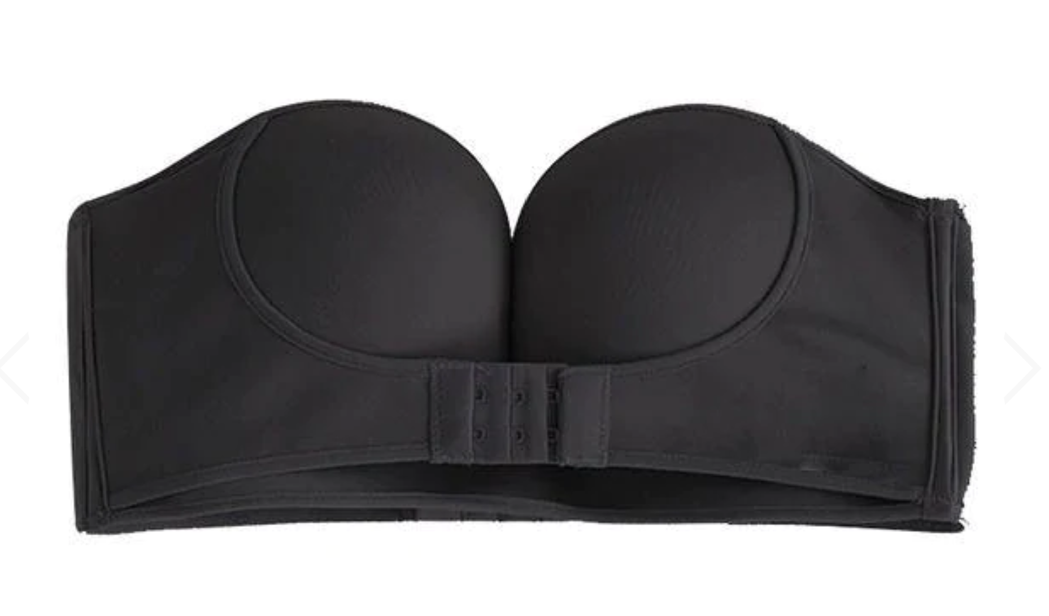
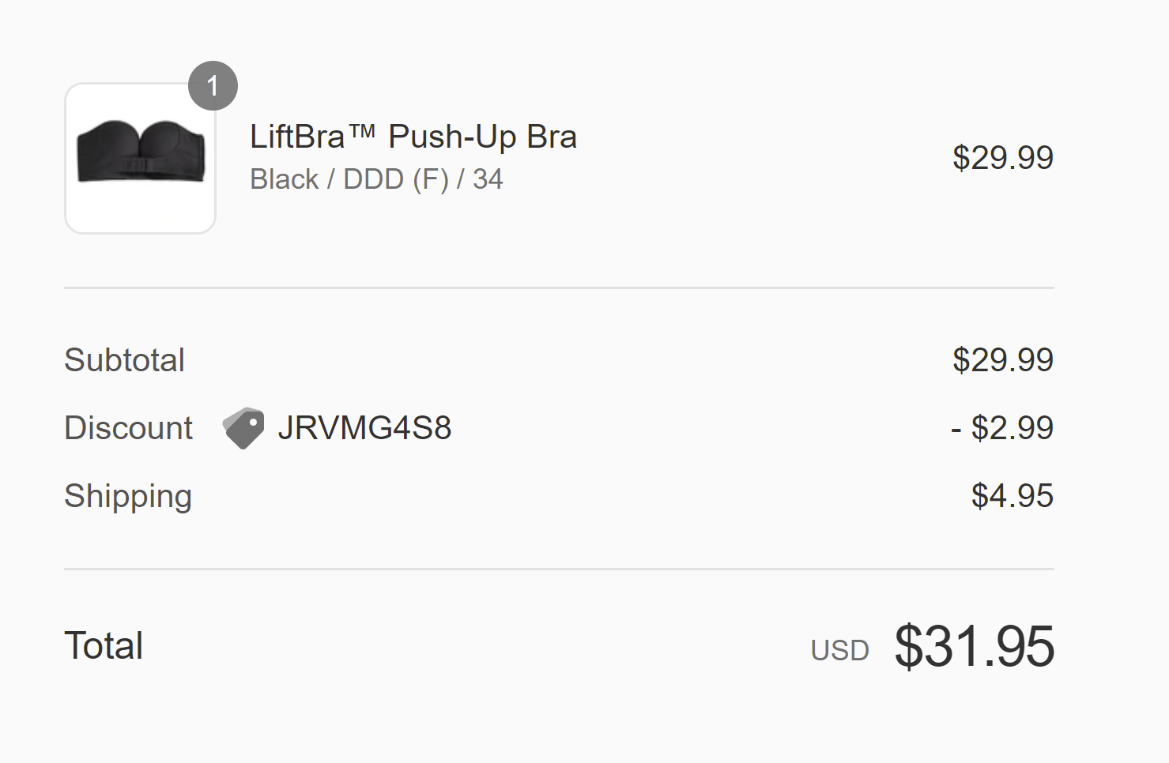
Strapless Bra
FOR SALE XL Bikini Top Original Price: $60, paid $31.95, worn only once (It is too small for me). Adjustable.
https://liftbra.co/products/strapless-bra?variant=37302328623269
Asking Price: $20

Slide 21
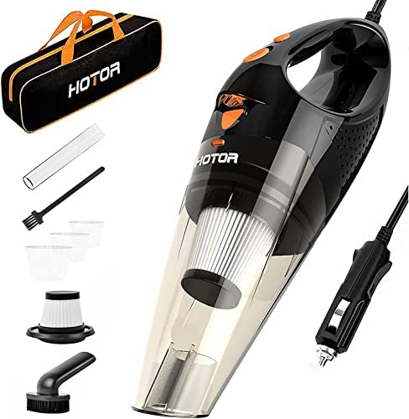
Car Vacuum Cleaner
Original Price: $27.00 , new filter installed
https://www.amazon.com/gp/product/B07CZWT9BT/ref=ppx_yo_dt_b_asin_title_o00_s00?ie=UTF8&psc=1
Asking Price: $15

